Slide 1


PRESENTATION
2020-2021
FUNDAMENTALS OF HYPERSONIC FLOW
Prof. Aldo Frezzotti
Submitted by
Vayshnu Kasi 10700106
POLITECNICO DI MILANO

Slide 2
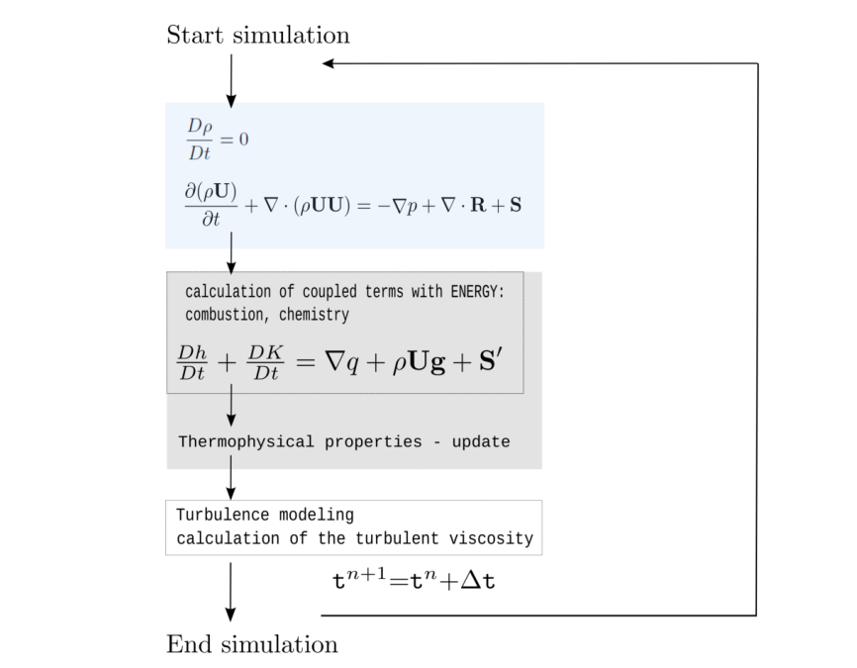
rhoCentralFoam….
Shock capturing method
Thermodynamics of hypersonic flows
POLITECNICO DI MILANO

Slide 3
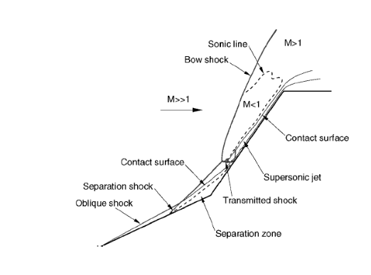
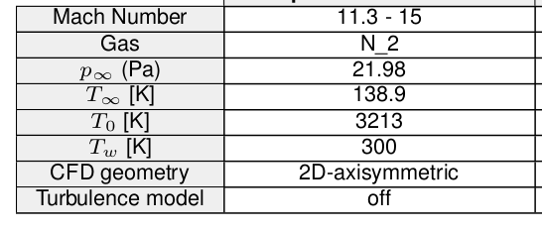
project that I interested
Sharp-Nosed Double Cone
Boundary condition
To model and simulate we use the OpenFOAM
Case setup by the following tutorial
The 2D-axisymmetric grid in blockMesh.
$FOAM_TUTORIALS/compressible/rhoCentralFoam/LadenburgJet60psi/system/blockMeshDict
$FOAM_TUTORIALS/compressible/rhoCentralFoam/biconic25-55Run35
POLITECNICO DI MILANO

Slide 4
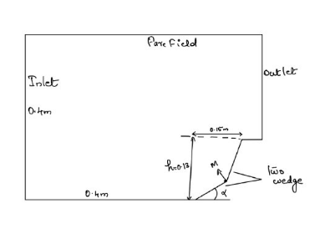

How to setup in OpenFOAM
Outline of the geometry
Geometry in paraview (surface)
This is solid geometry for the sharp-nose double cone
M
The solver which we used for numerical simulation is rhoCentralFoam with explicit shock capturing method
No Temperature modeling
No Chemical reaction are going on
M is the moving point near by the separation zone using this point can able to set the angle as 20°,25°,30°.35°
Equation of state is respected p=p(?,T) ϒ=1.4 Kn<0.01(region of continues mechanics Navier stokes equation hold every where in the flow field)
POLITECNICO DI MILANO

Slide 5

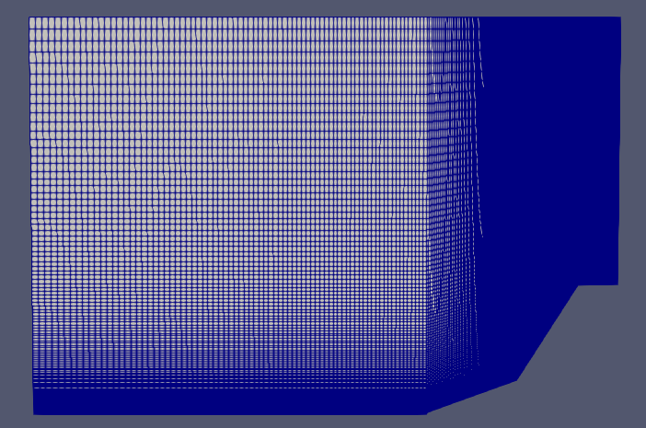
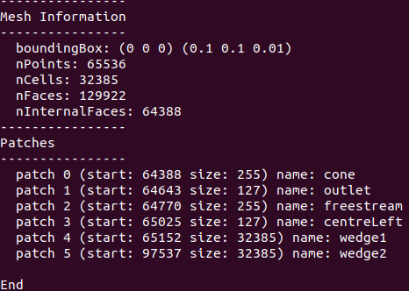
blockMeshDict
BlockMesh in paraFoam
Gmesh to create block structured grid and use wedge B.C to simulate axis symmetric flow
The region A of interested is fine meshed using simple grading in the blockMeshDict of the system folder
PolyMesh will be created in the constant folder after this generation
A
0/T folder : Inlet type is patch has fixed uniform value 138K,outlet and farfield B.C type is patch zero gradient ,wall type is wall Tԝ=300K,wedge 0 & wedge 1 set to be wedge
0/U folder : inlet uniform (Vx 0 0)
0/p folder :wall type is wall with zero gradient inlet type as fixed value and value as uniform
POLITECNICO DI MILANO

Slide 6
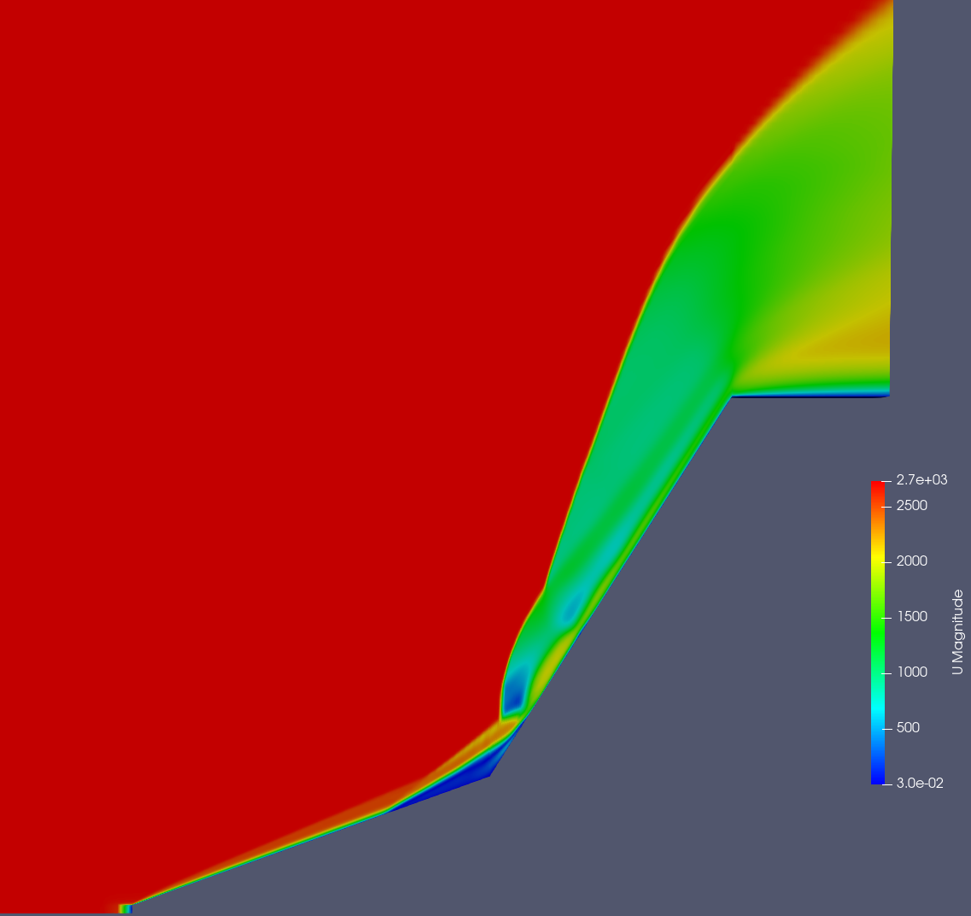
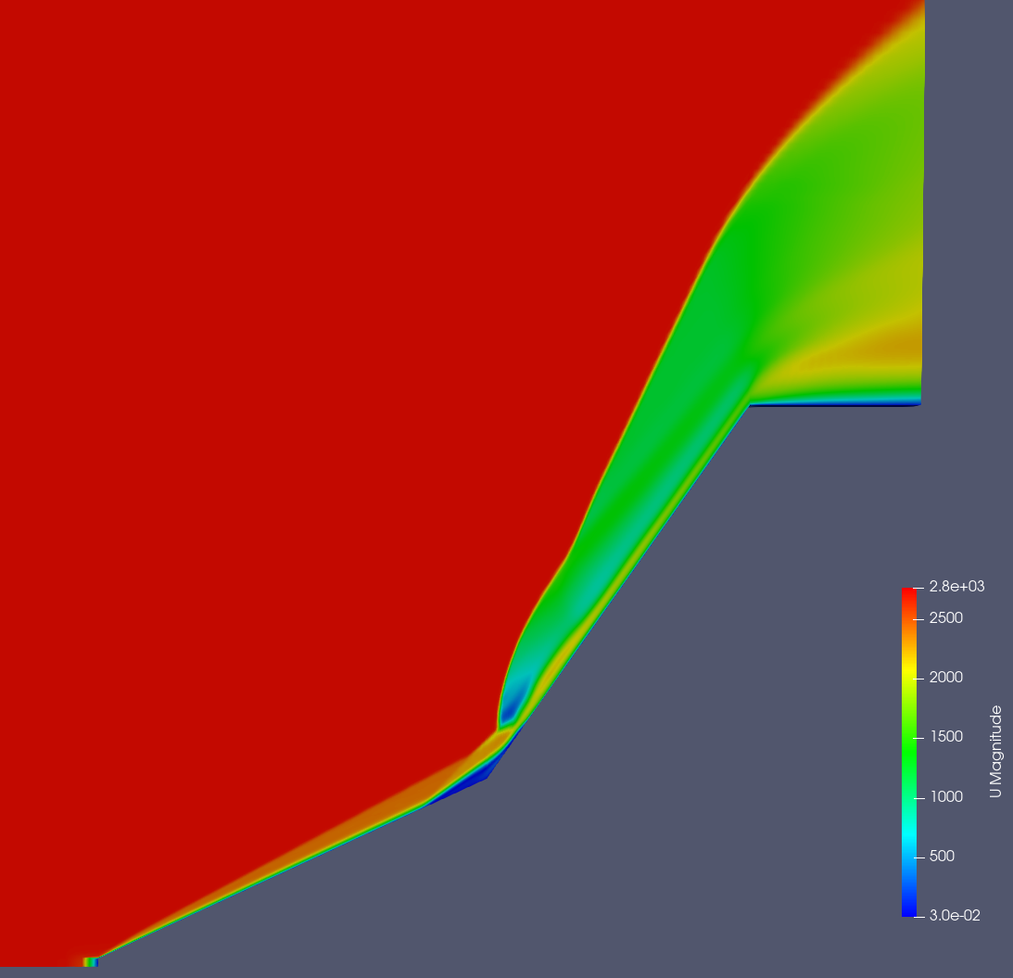
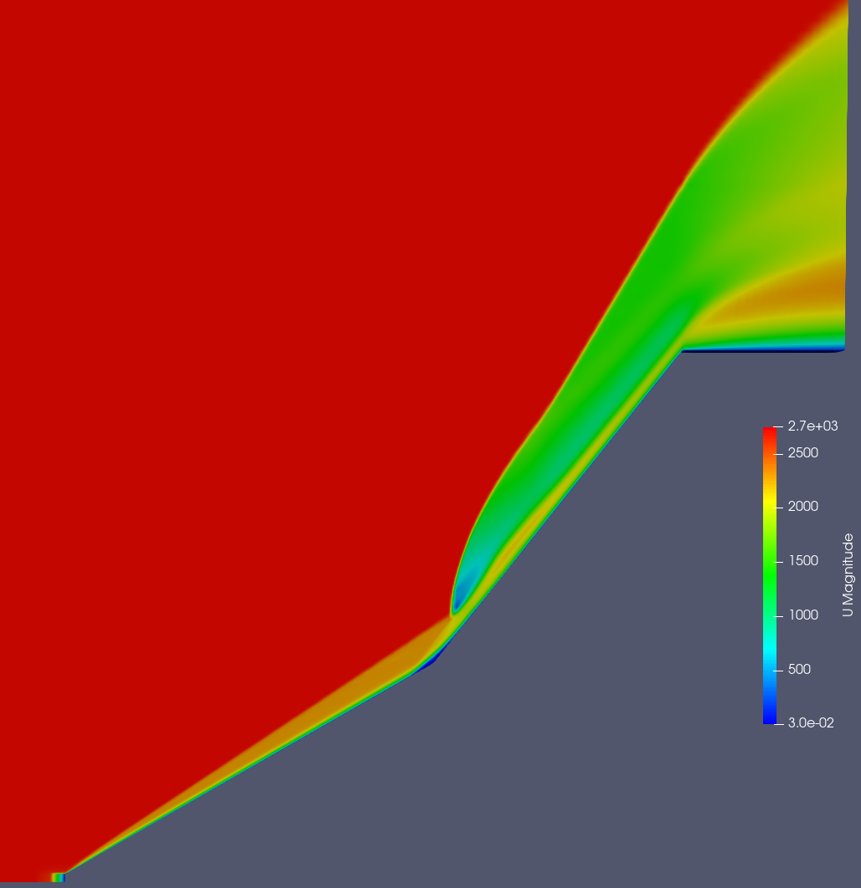
Result discussionUcontour@M=11.3
@20°
@25°
A
A
B
B
@30°
Supersonic jet
A Supersonic jet
B Separation zone
Separation zone
A
B
POLITECNICO DI MILANO

Slide 7
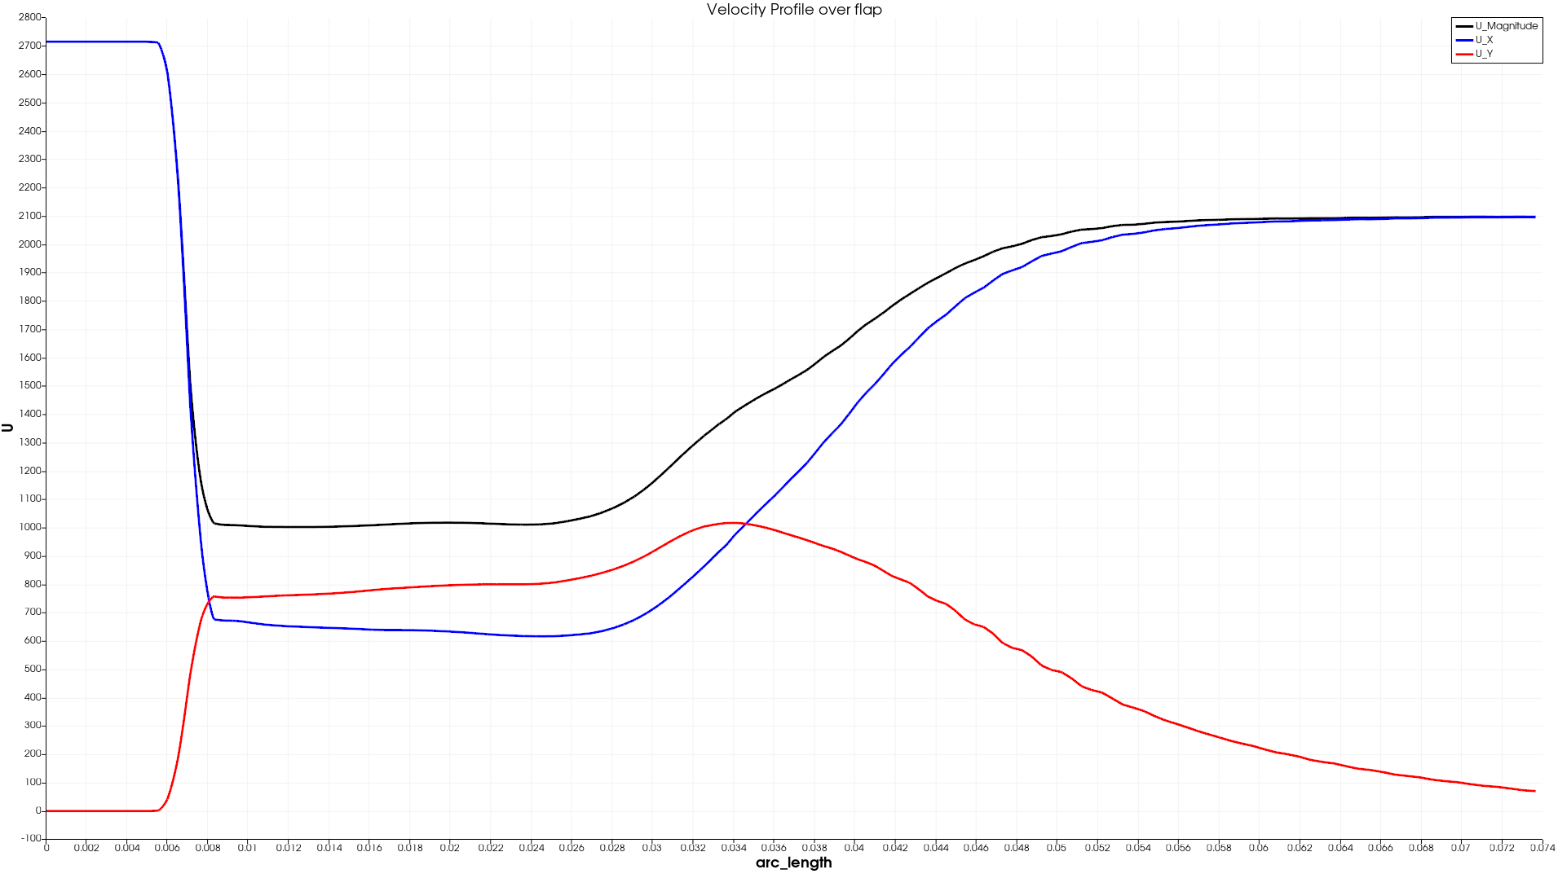
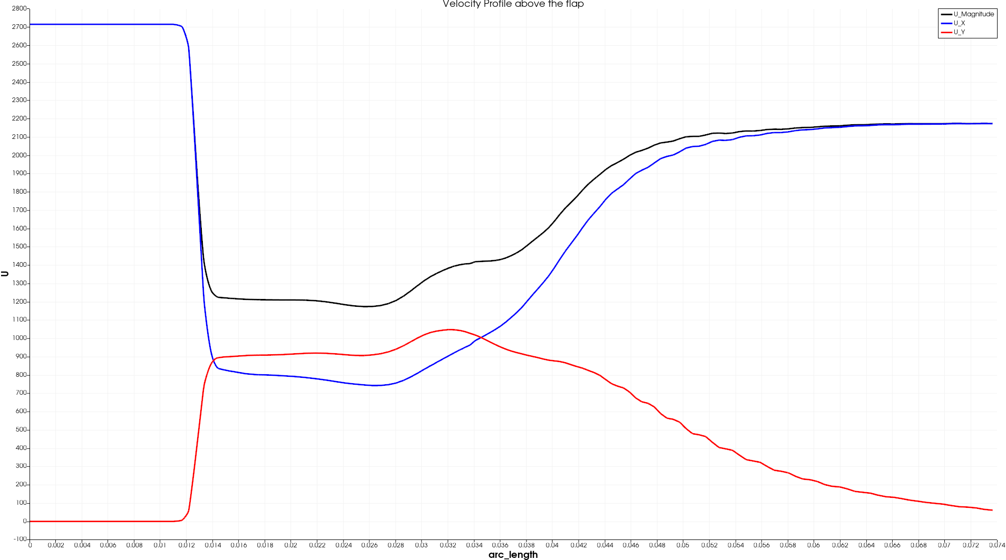
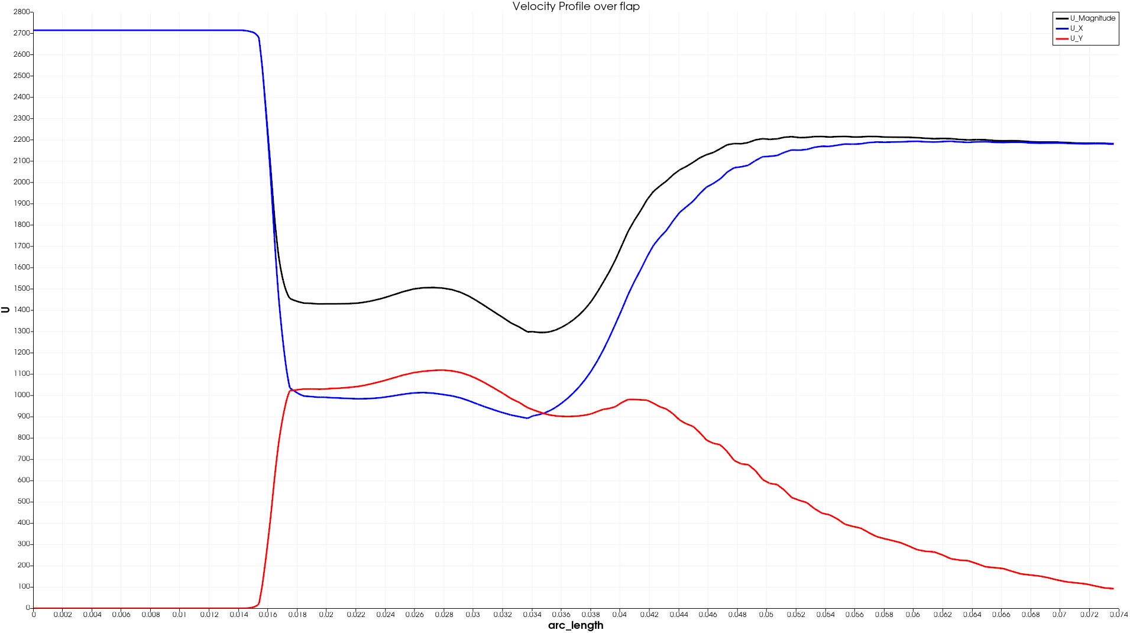
Velocity profile over flap
@20°
@25°
@30°
Separation zone
POLITECNICO DI MILANO

Slide 8
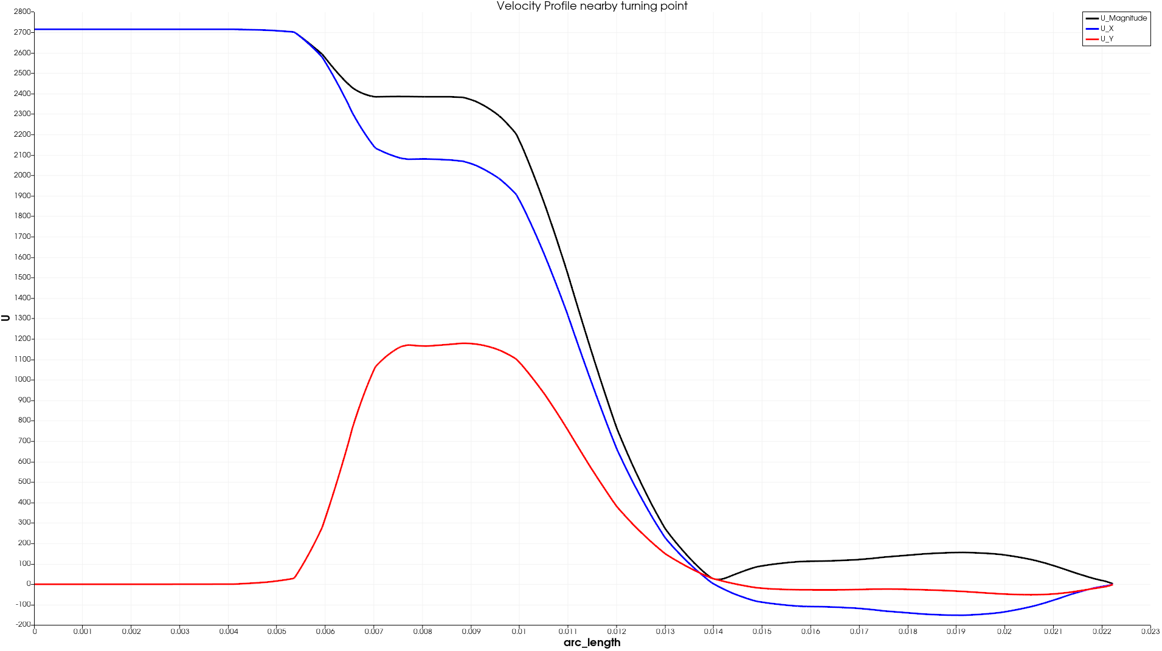
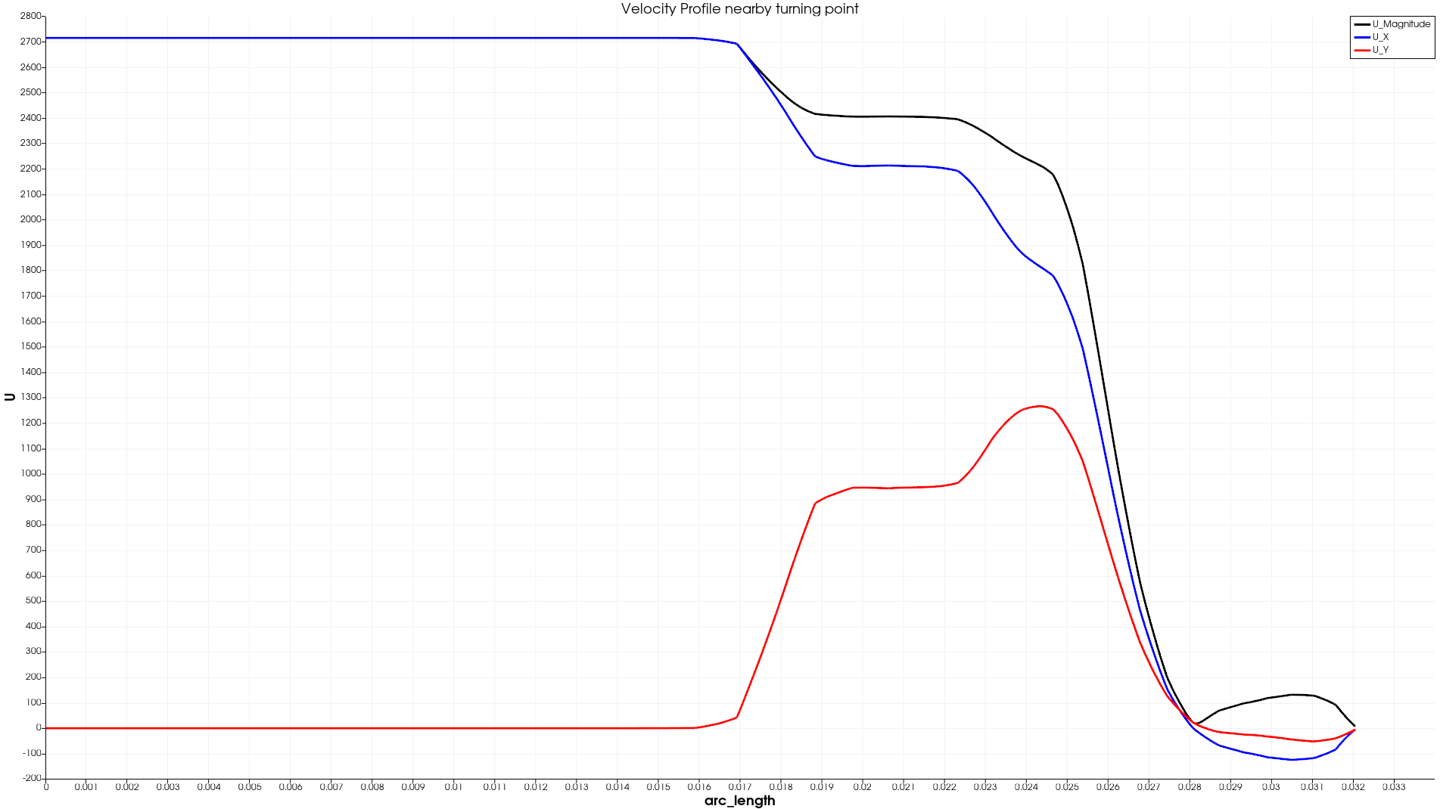
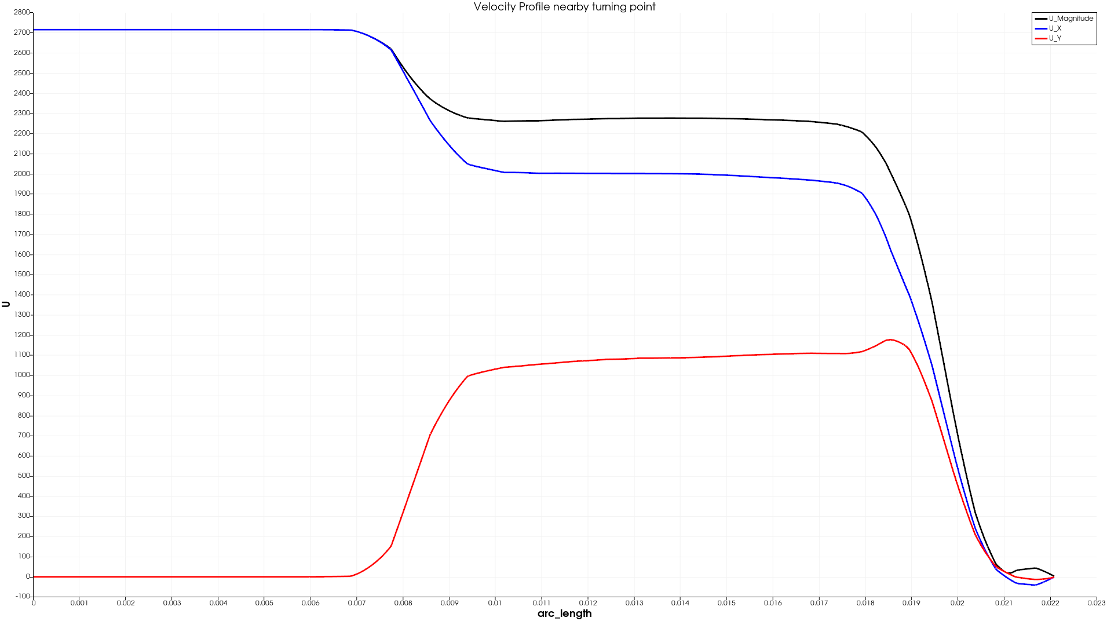
Velocity profile separation zone
@20°
@25°
@30°
Separation zone
POLITECNICO DI MILANO

Slide 9
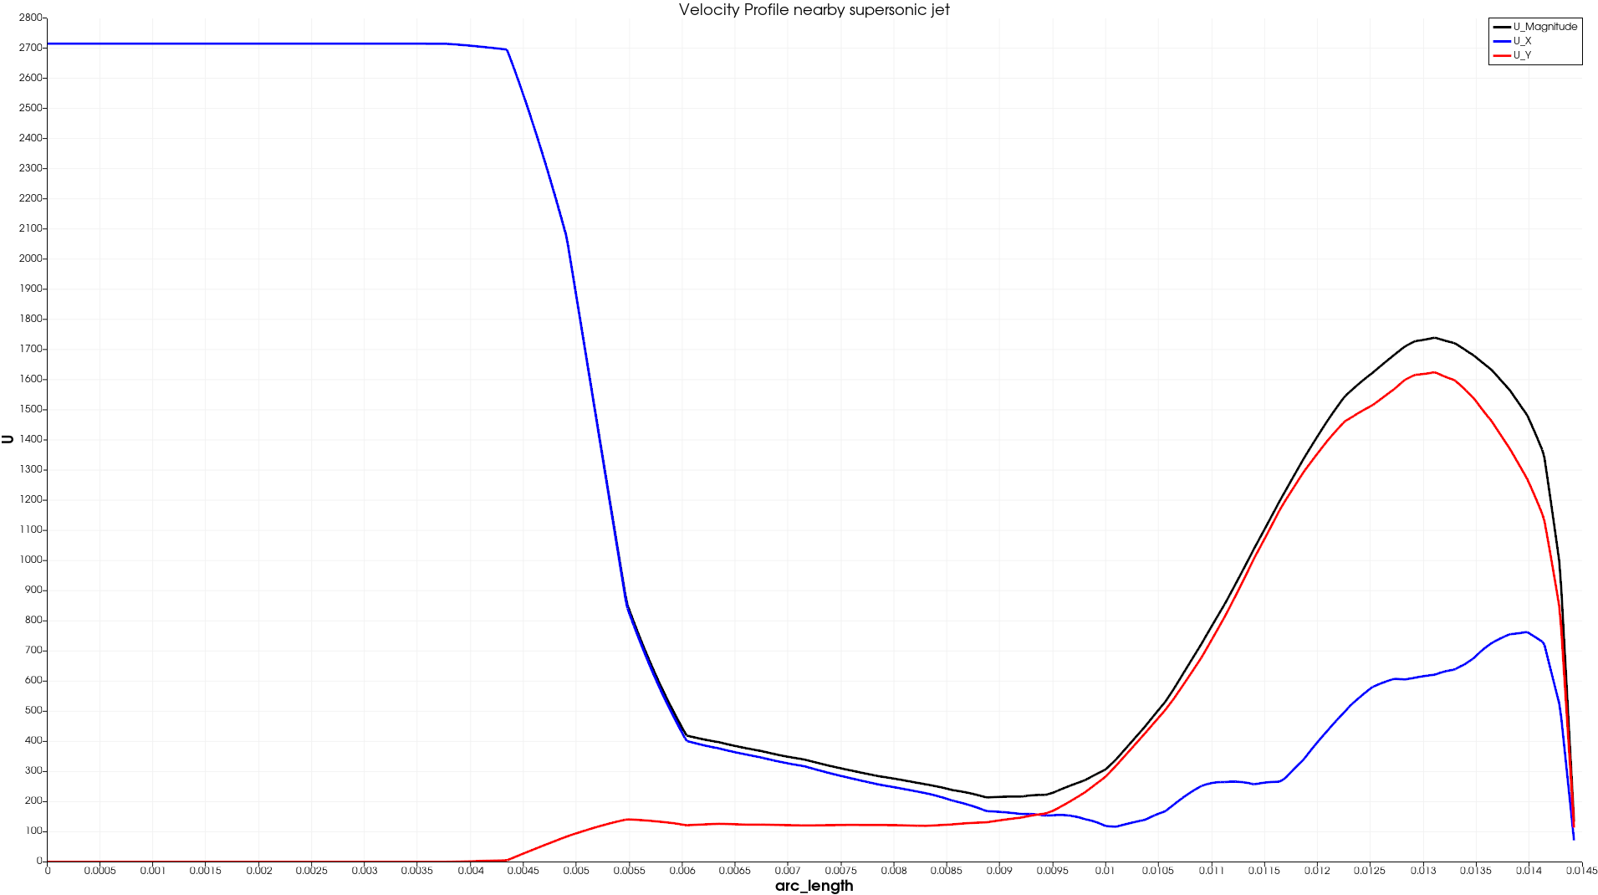
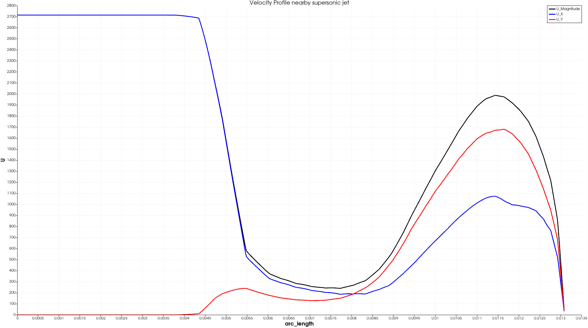
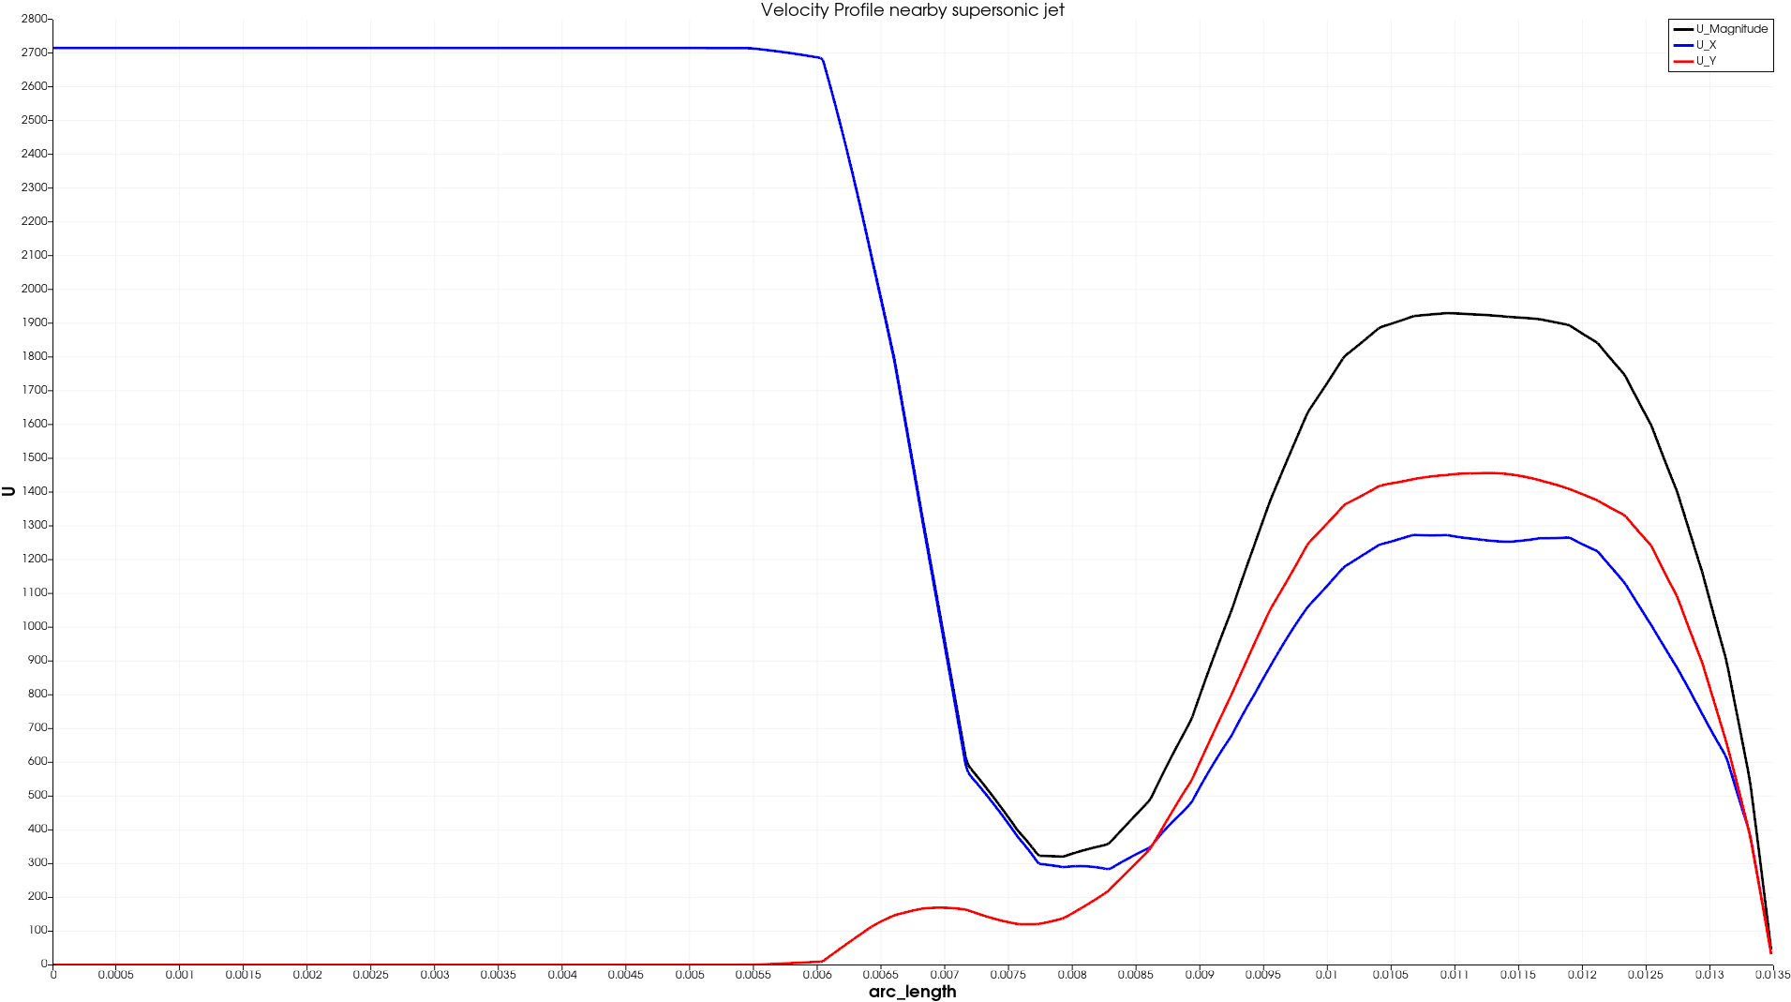
Velocity profile supersonic jet
@20°
@25°
@30°
POLITECNICO DI MILANO

Slide 10
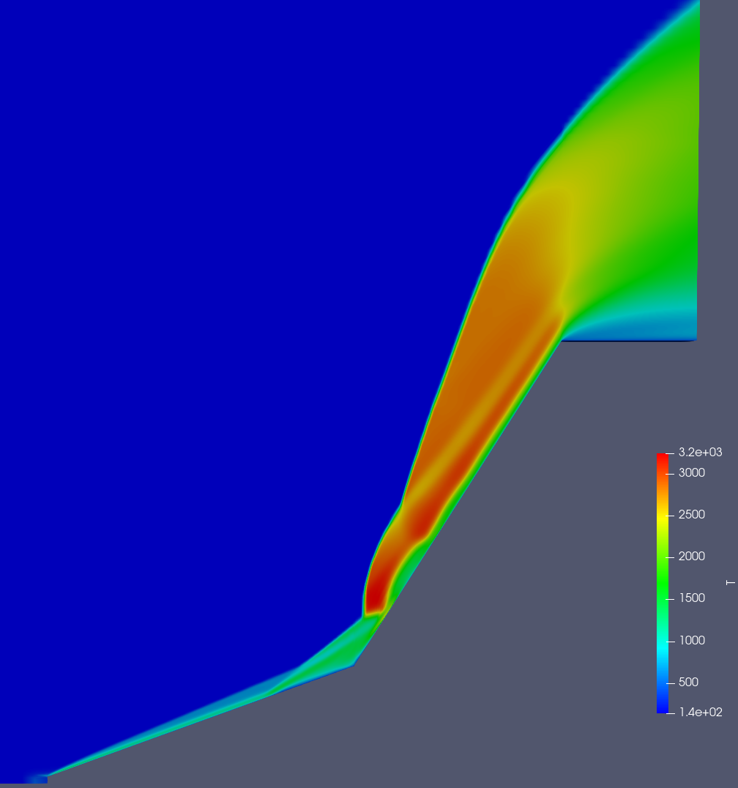
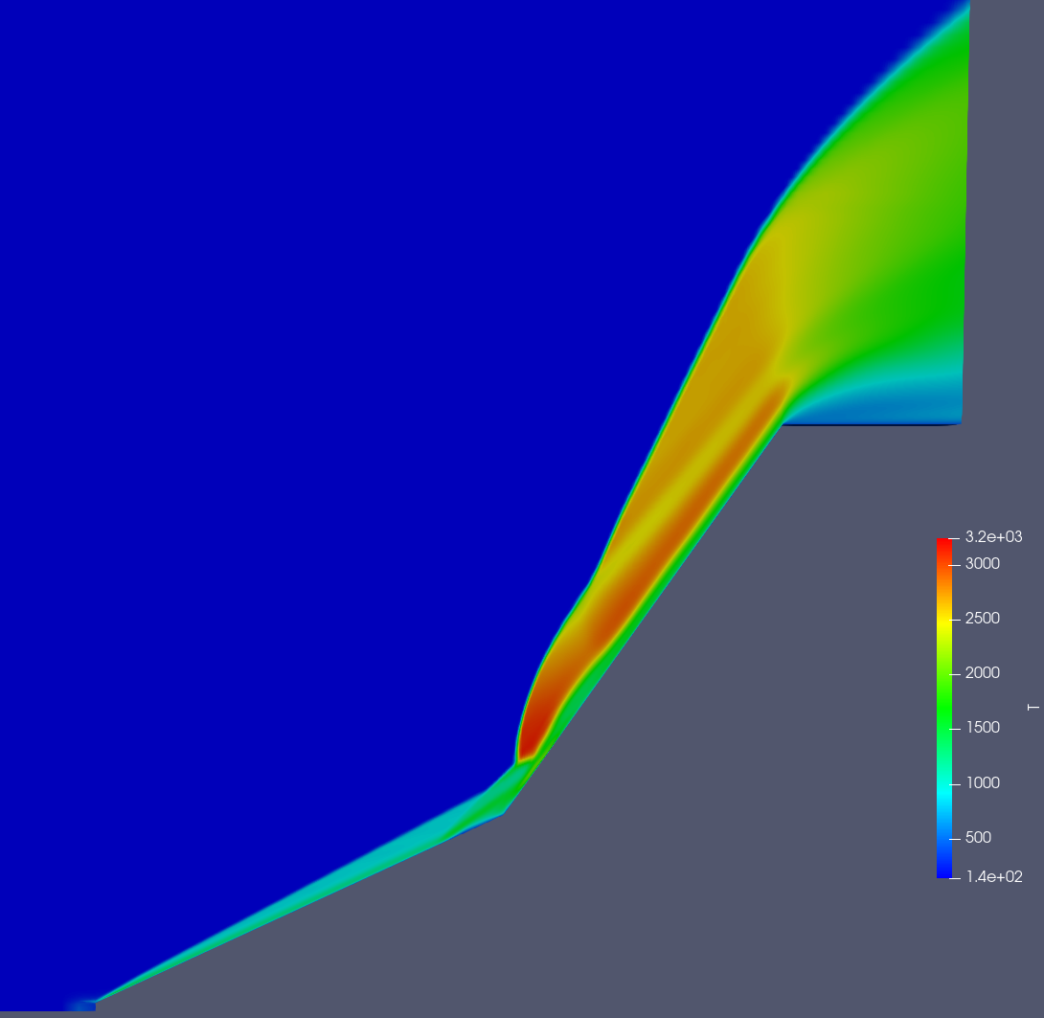
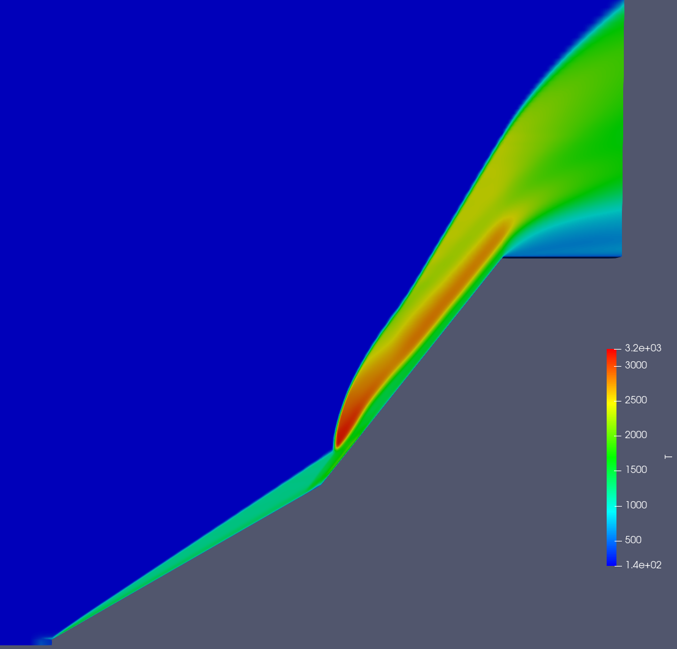
Temperature profile @ M=11.3
@20°
@25°
A
A
B
B
@30°
A Supersonic jet
B Separation zone
A
B
POLITECNICO DI MILANO

Slide 11
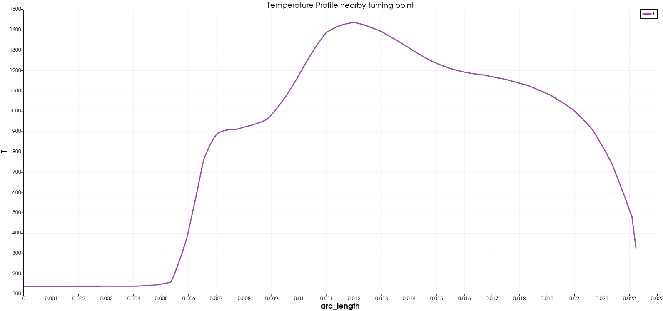
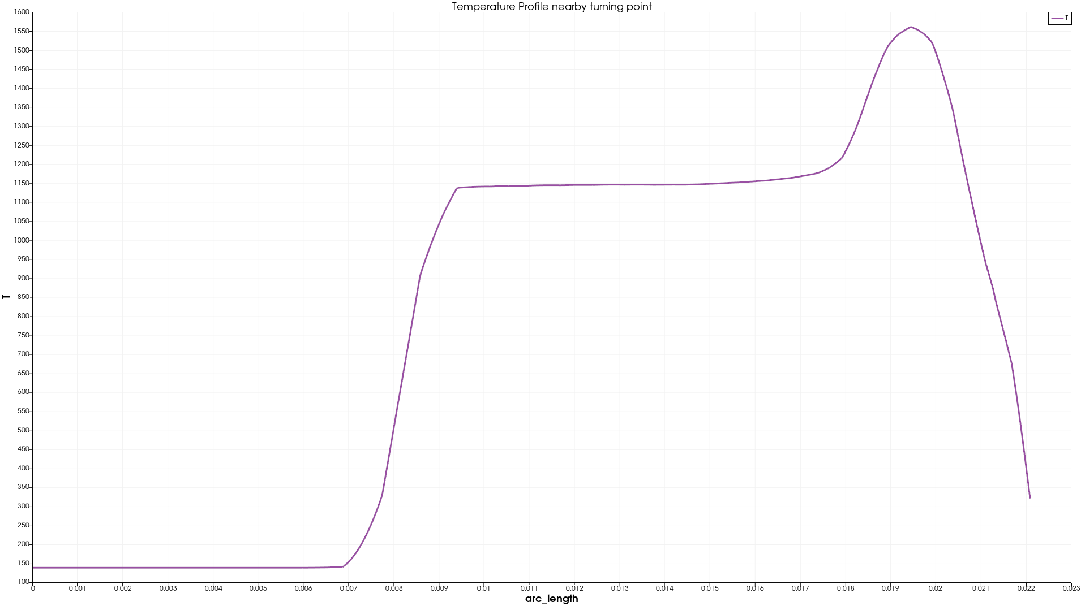
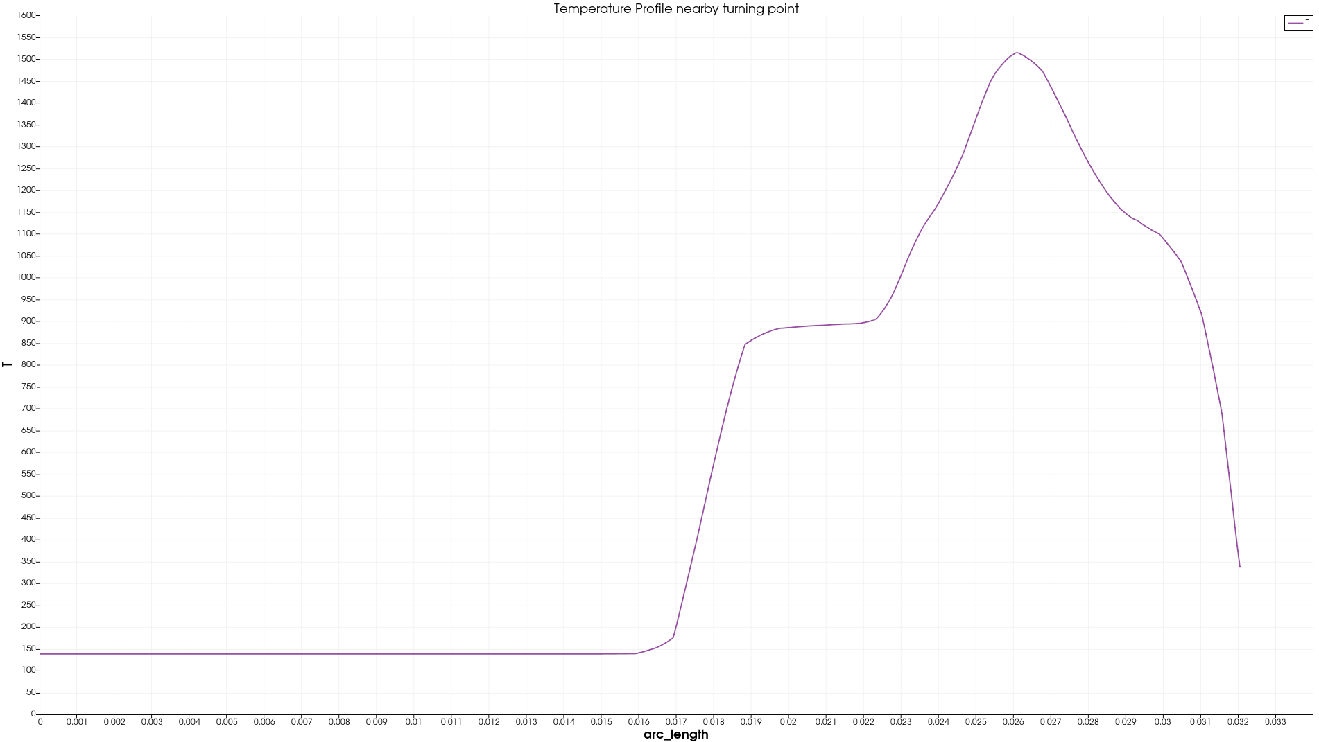
Temperature profile separation zone
@20°
@25°
@30°
POLITECNICO DI MILANO

Slide 12
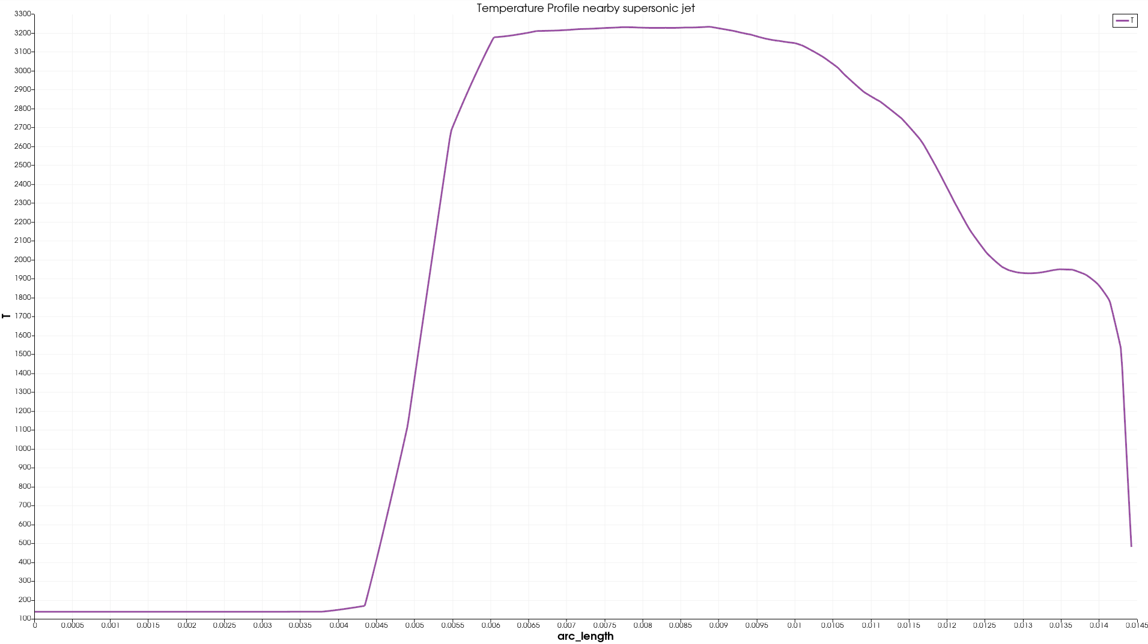
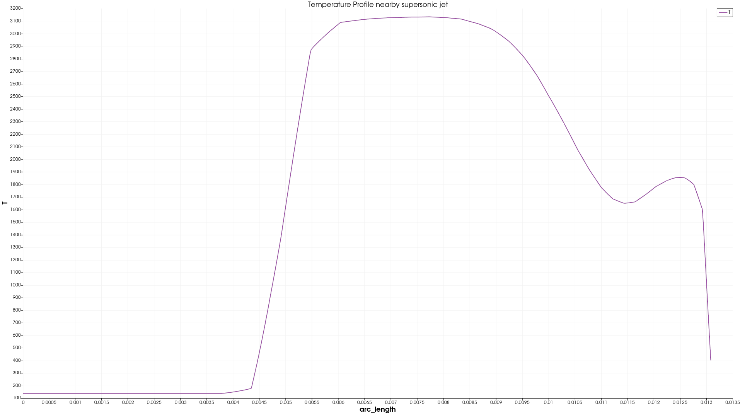
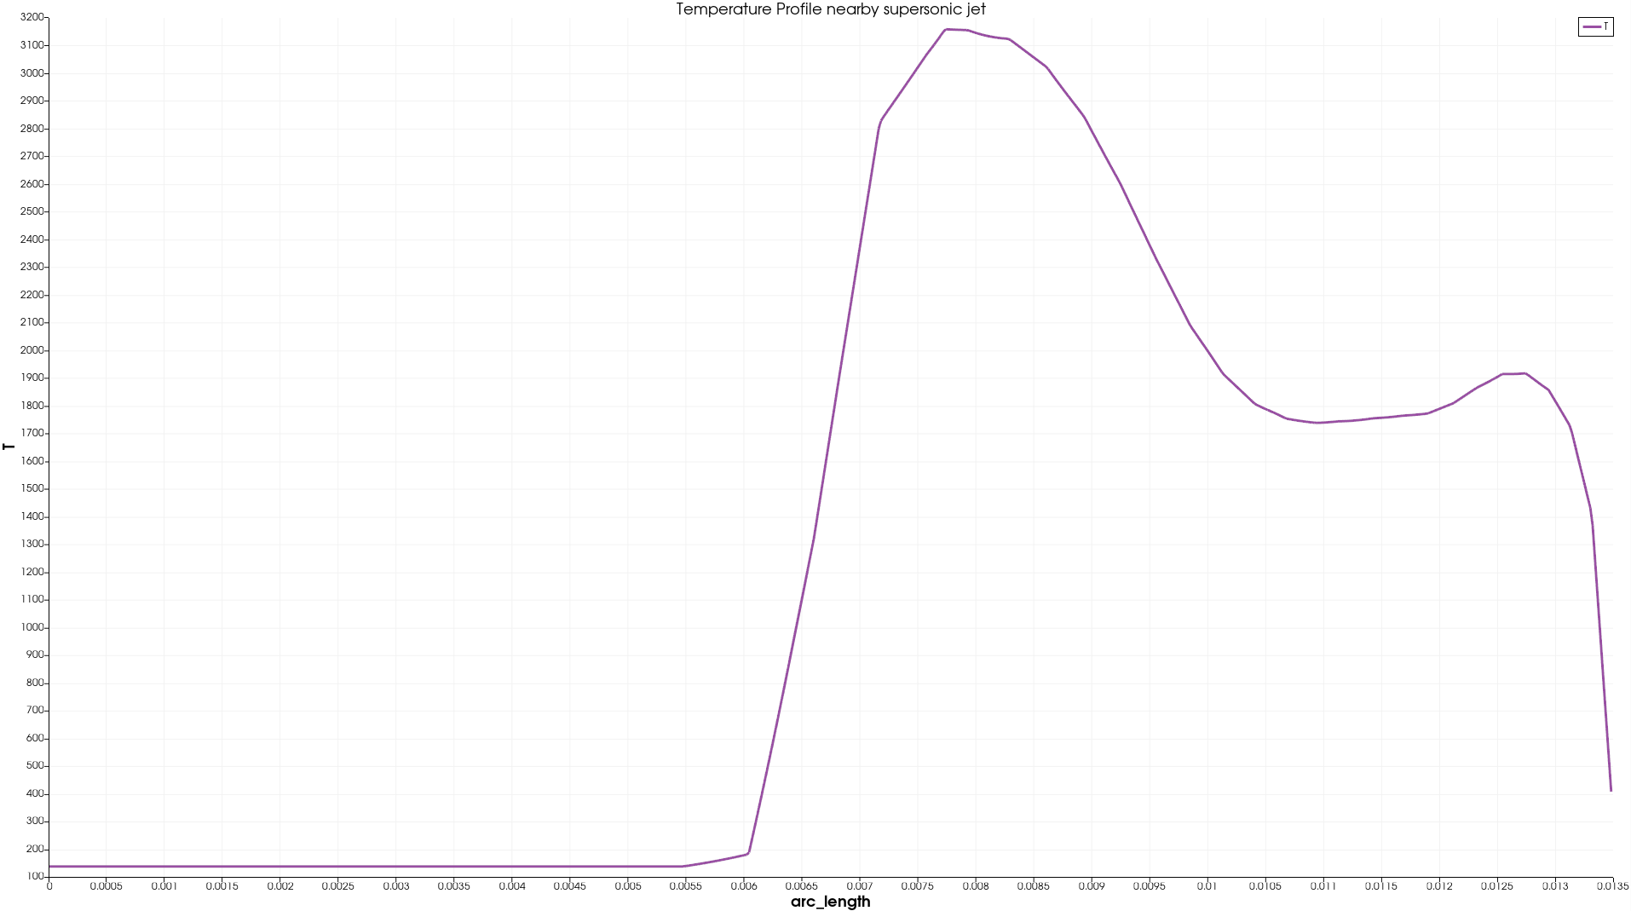
Temperature profile supersonic jet
@25°
@20°
@30°
POLITECNICO DI MILANO

Slide 13
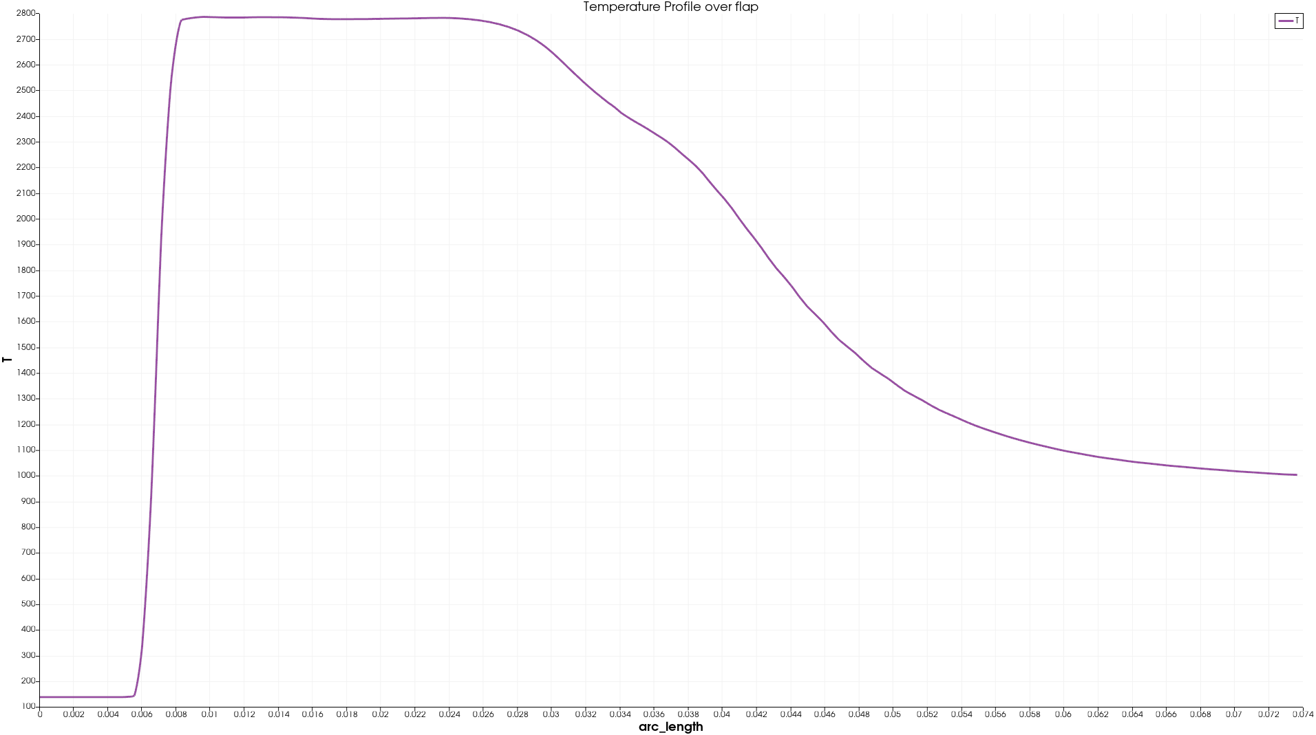
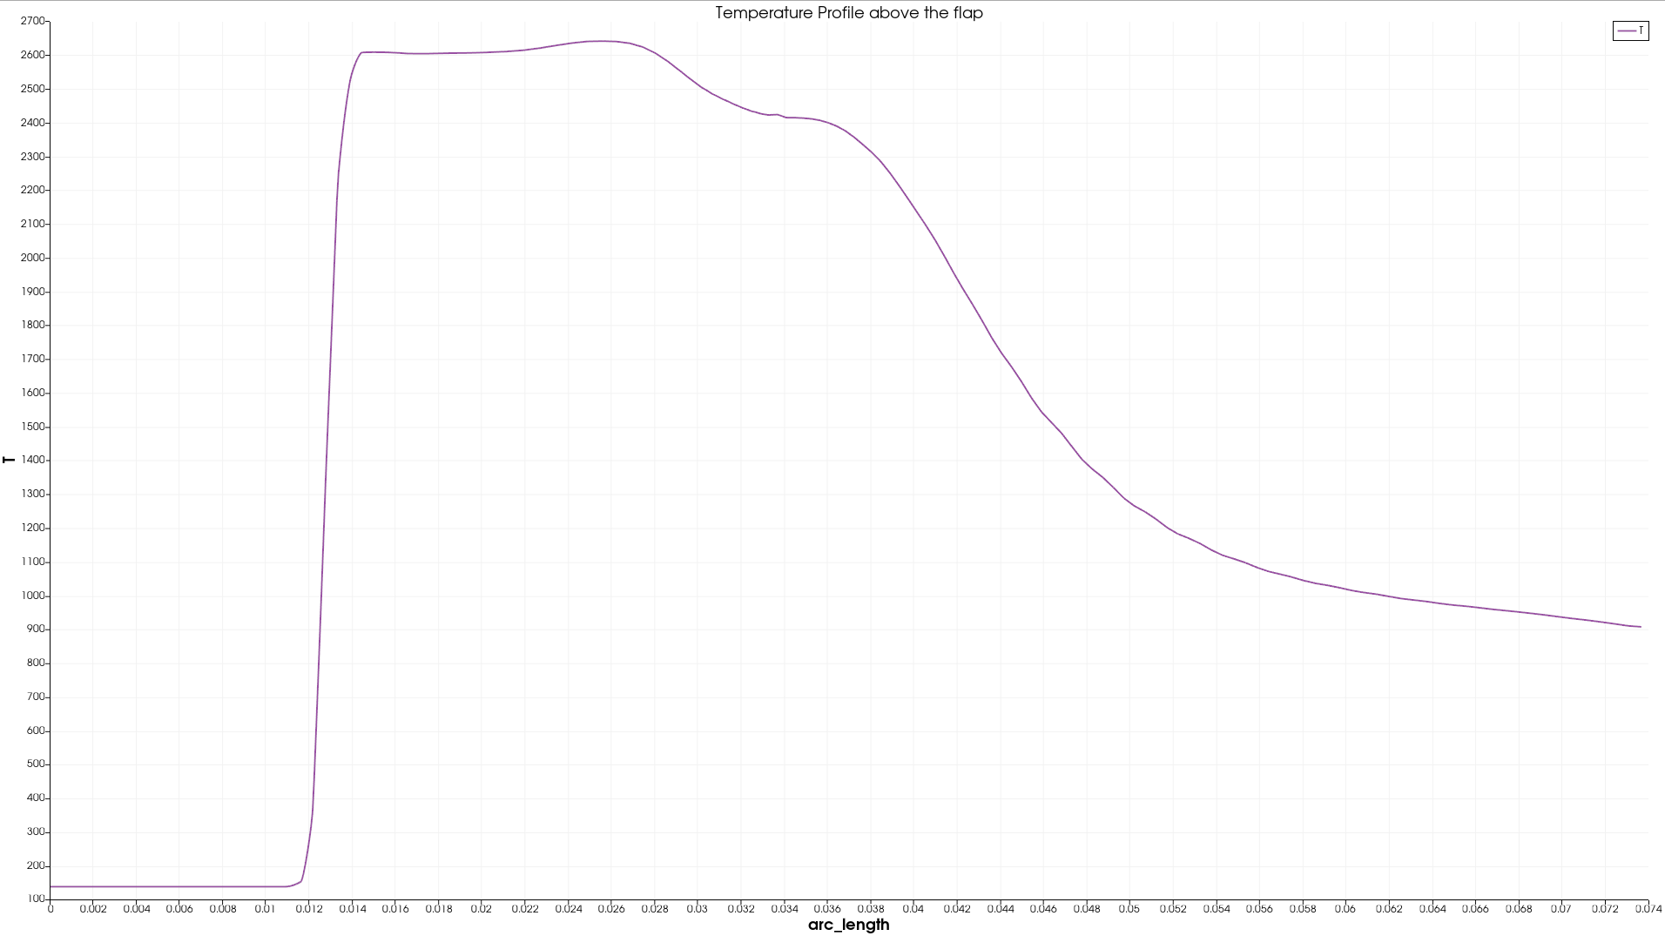
Temperature profile over the flap
@20°
@25°
@30°
POLITECNICO DI MILANO

Slide 14
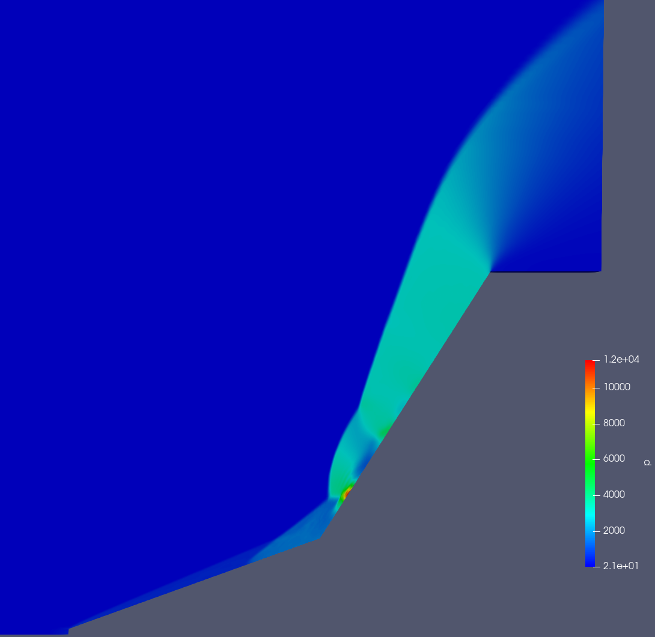
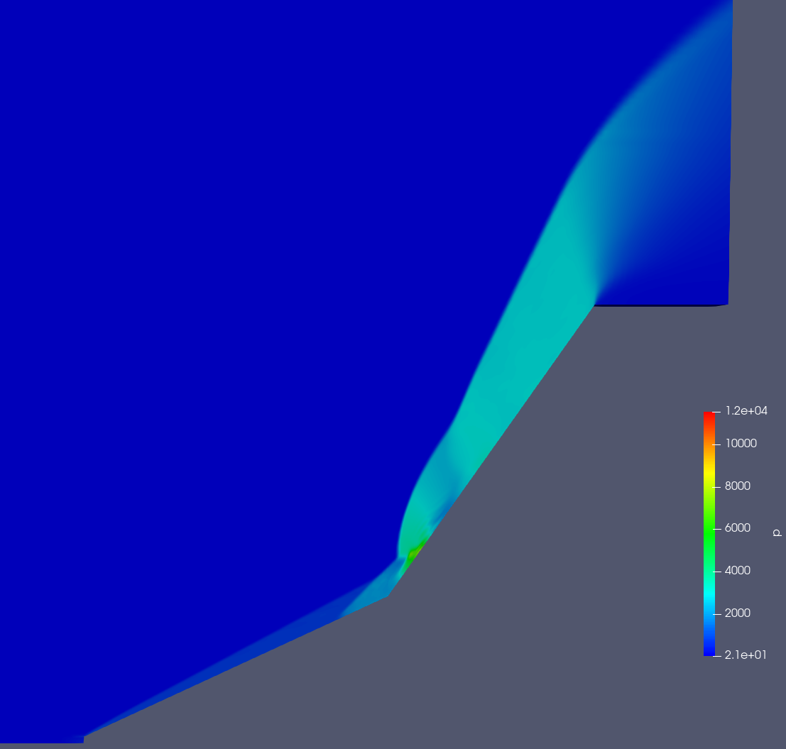
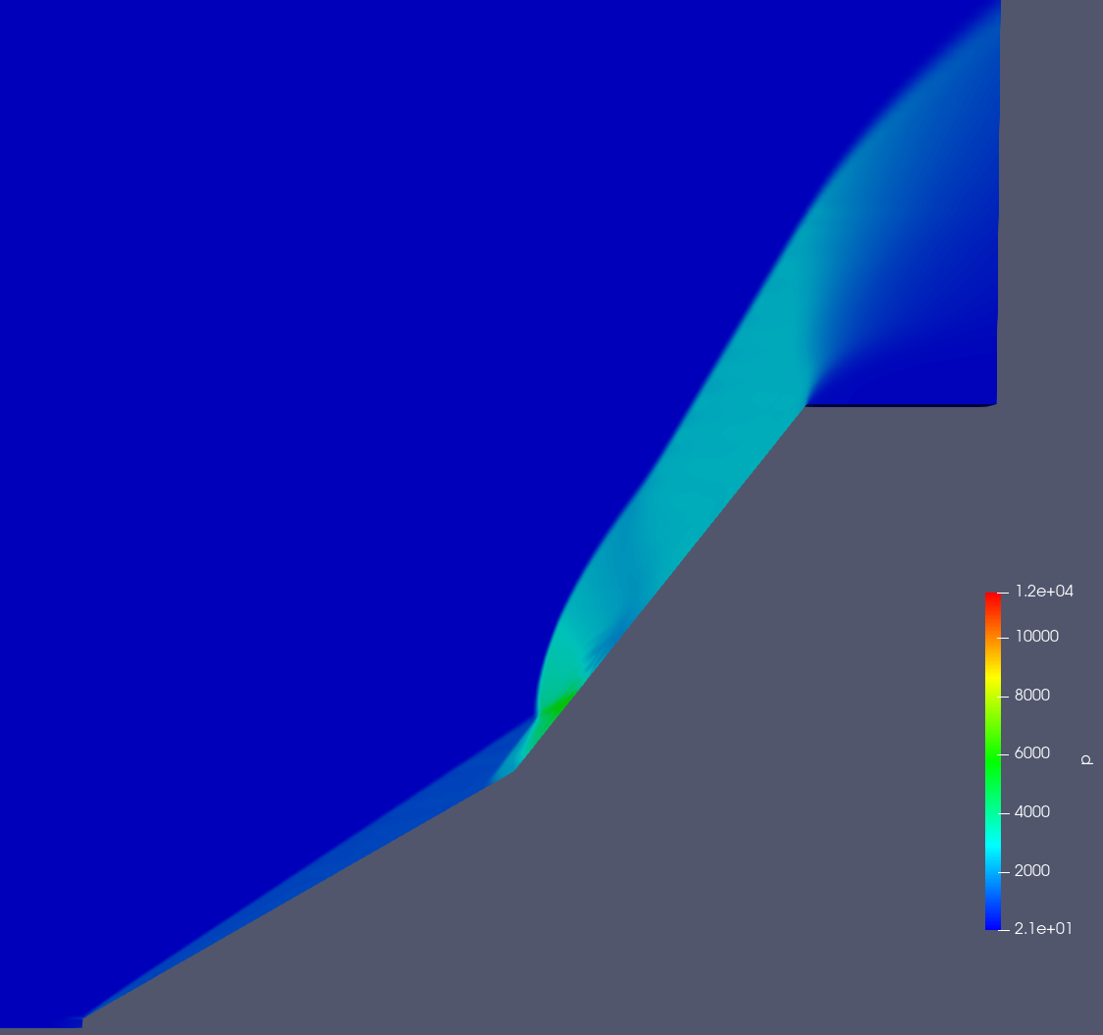
Pressure contour @M=11.3
@20°
@25°
A
A
B
B
@30°
A Supersonic jet
B Separation zone
A
B
POLITECNICO DI MILANO

Slide 15
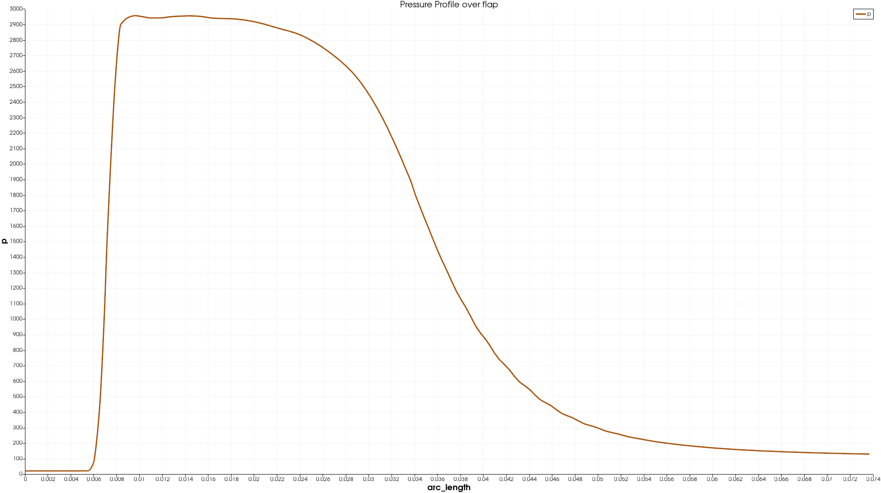
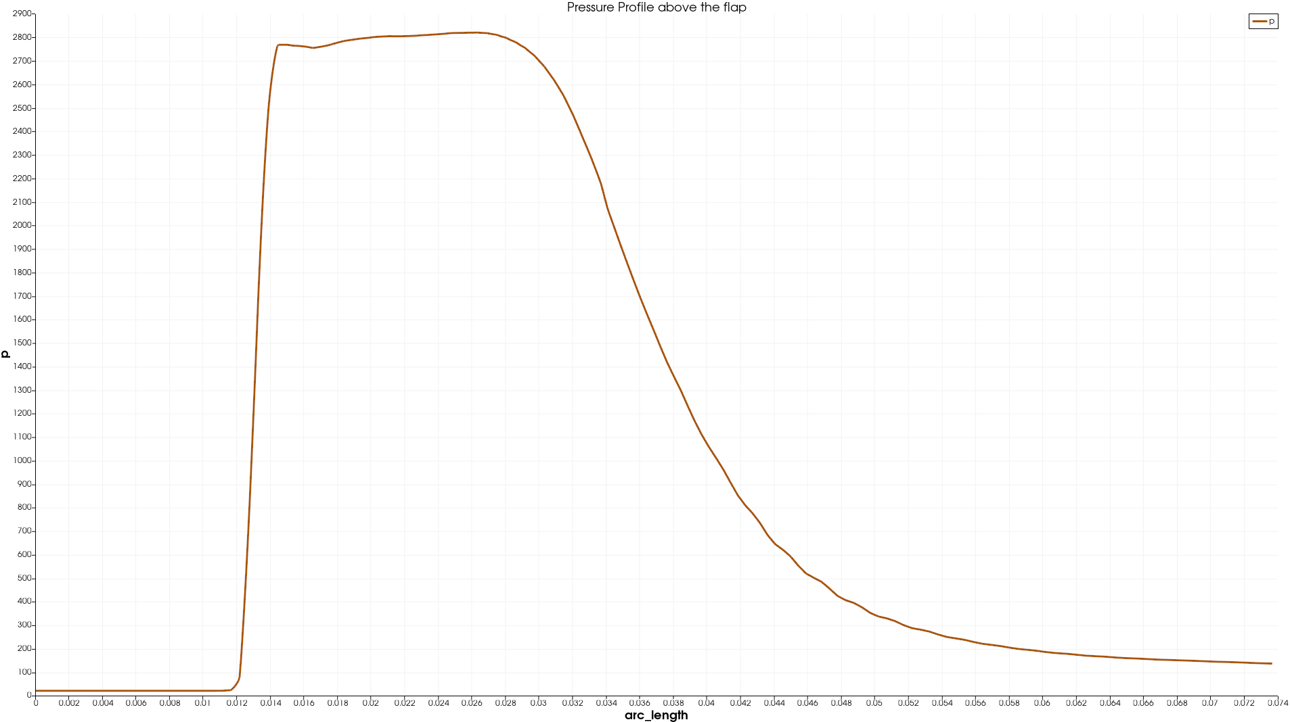
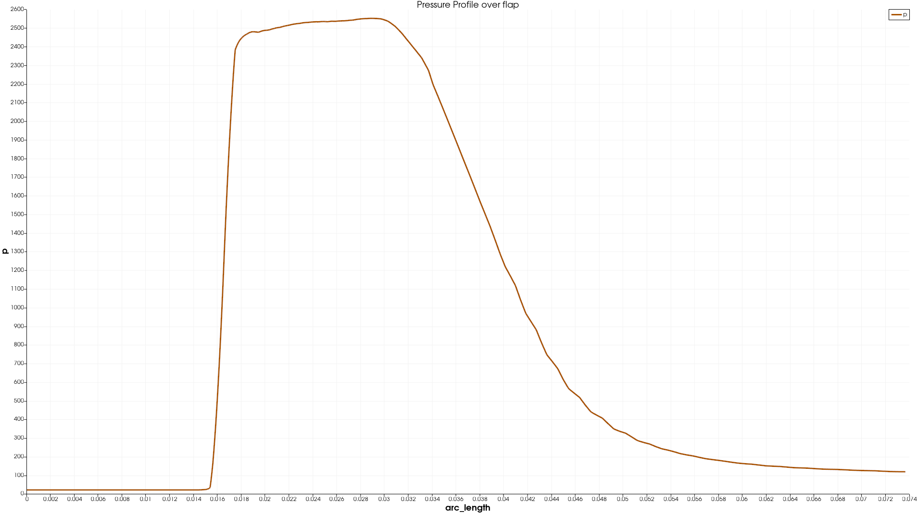
Pressure profile over the flap
@25°
@20°
@35°
POLITECNICO DI MILANO

Slide 16
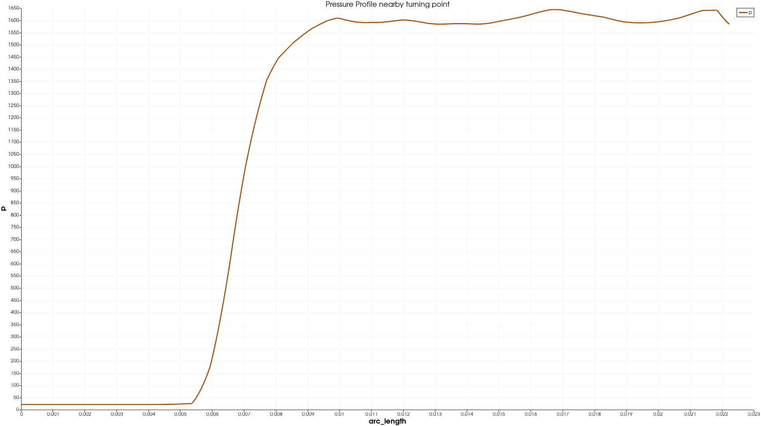
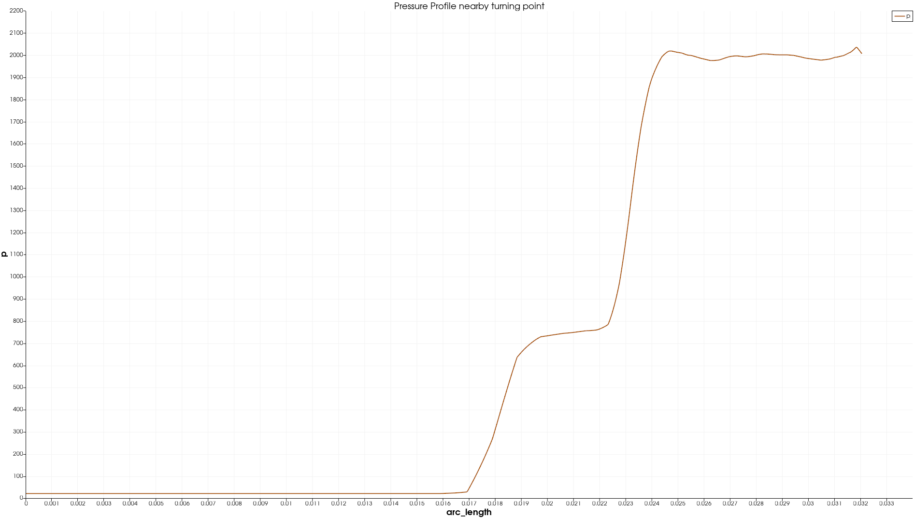
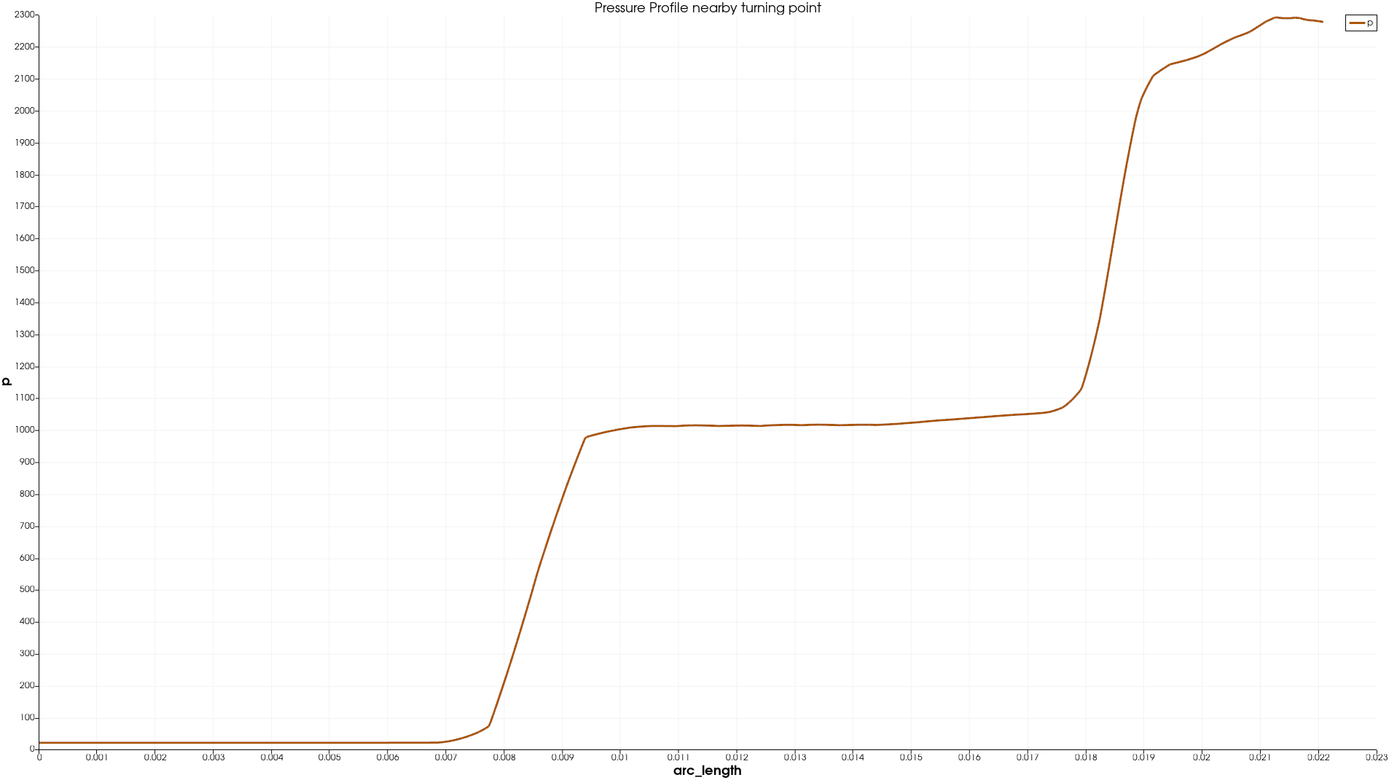
Pressure profile over separation zone
@20°
@25°
@30°
POLITECNICO DI MILANO

Slide 17
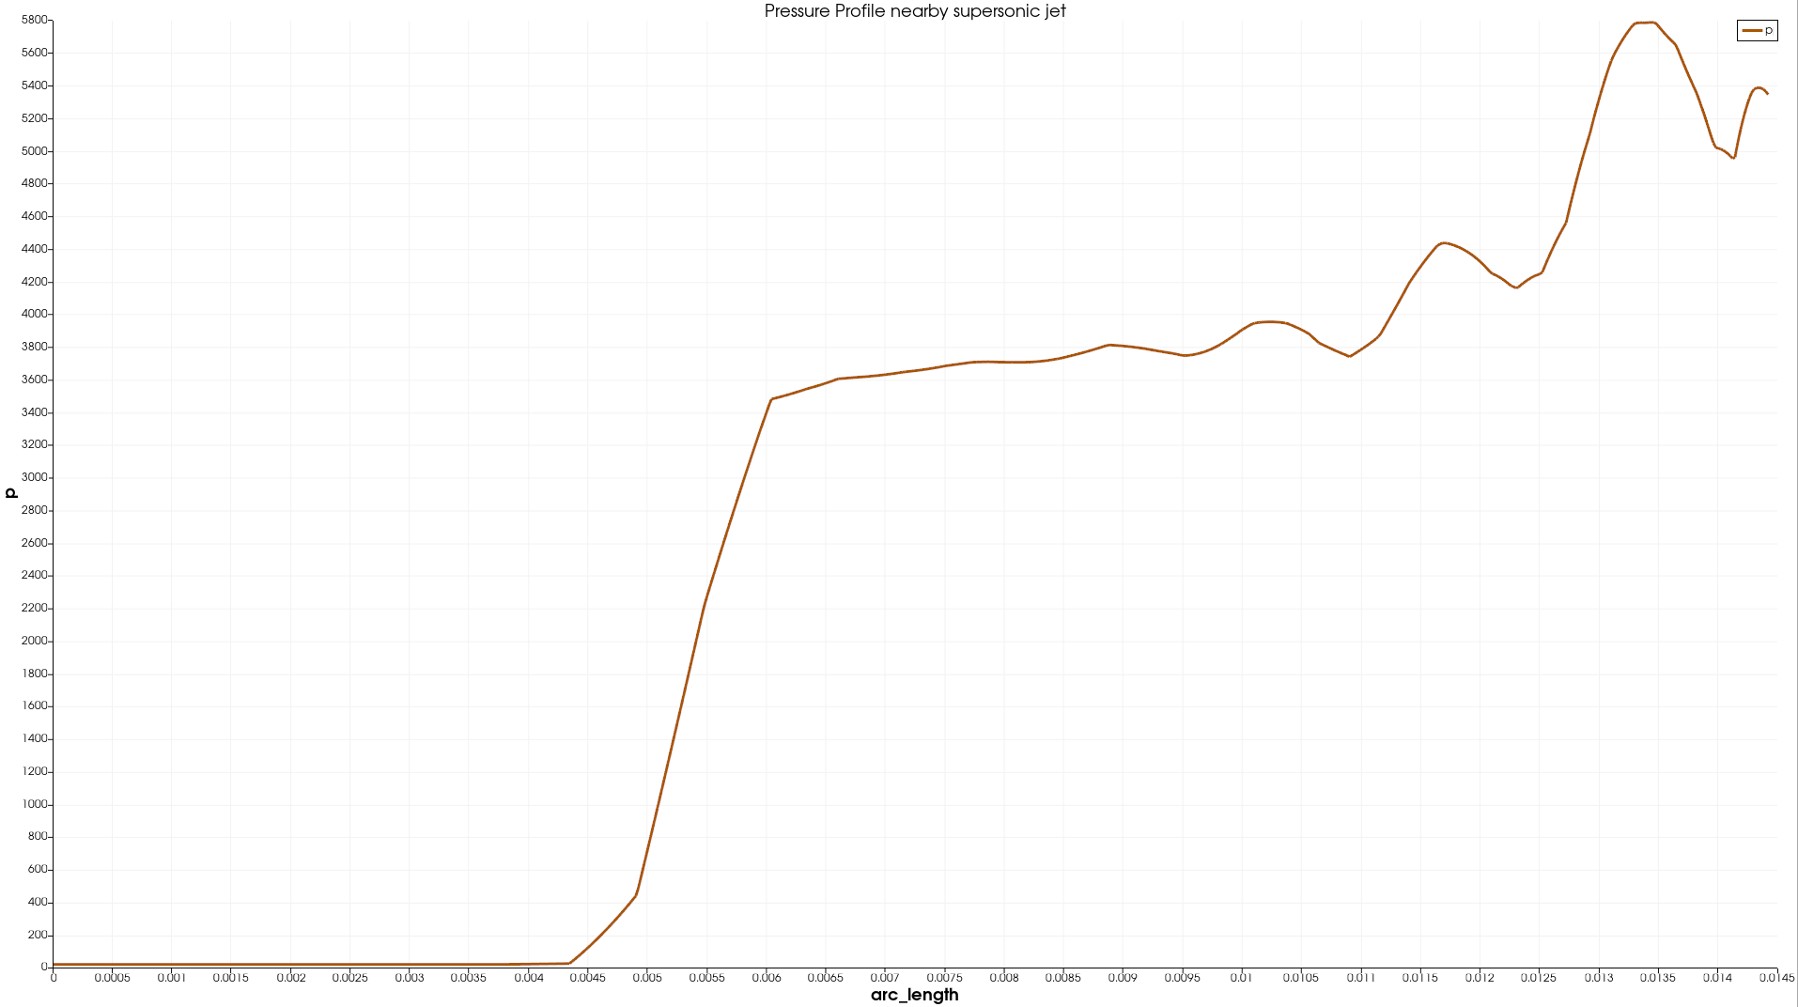
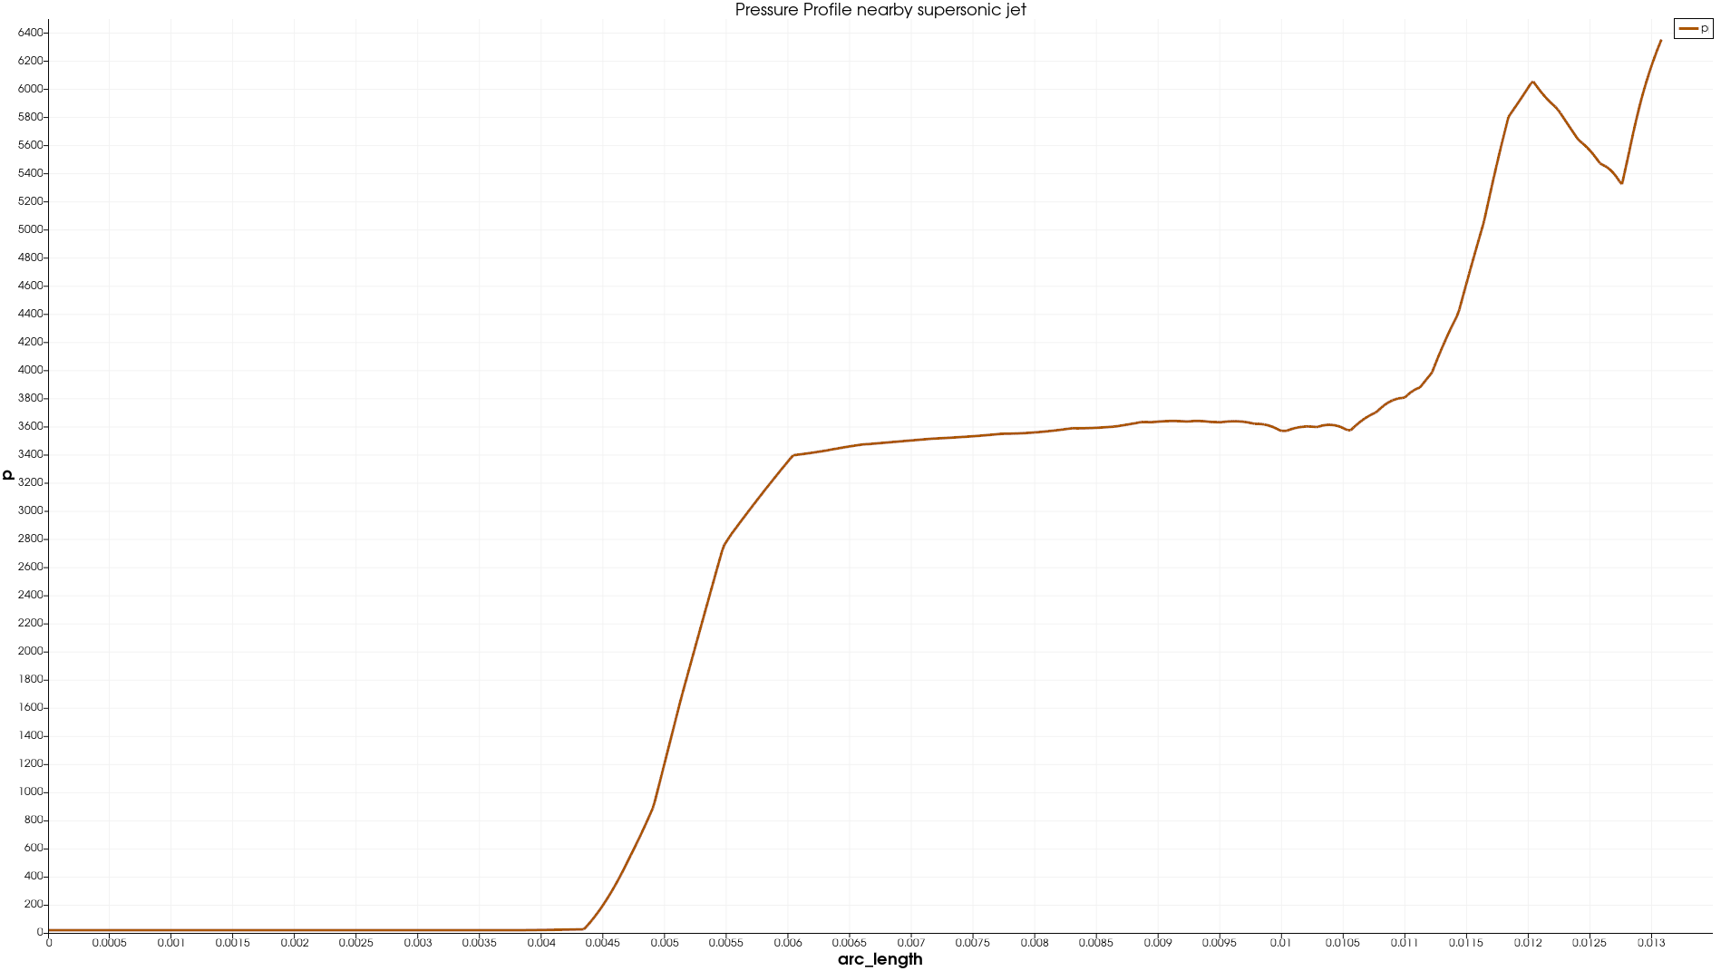
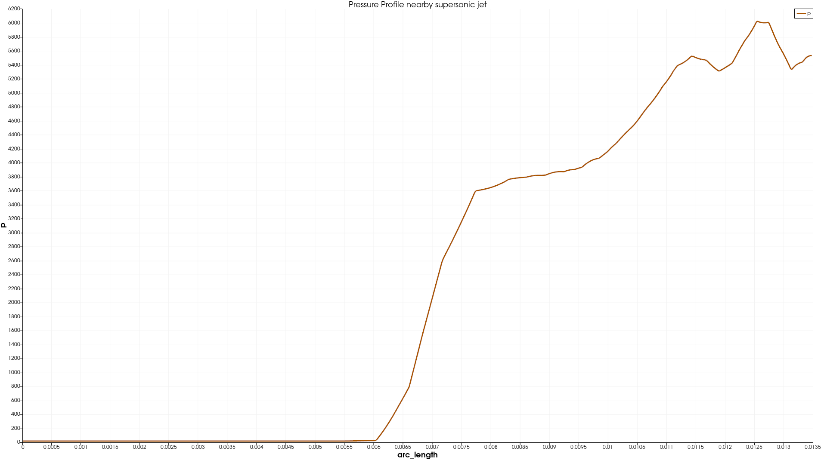
Pressure profile supersonic jet
@20°
@25°
@30°
POLITECNICO DI MILANO

Slide 18
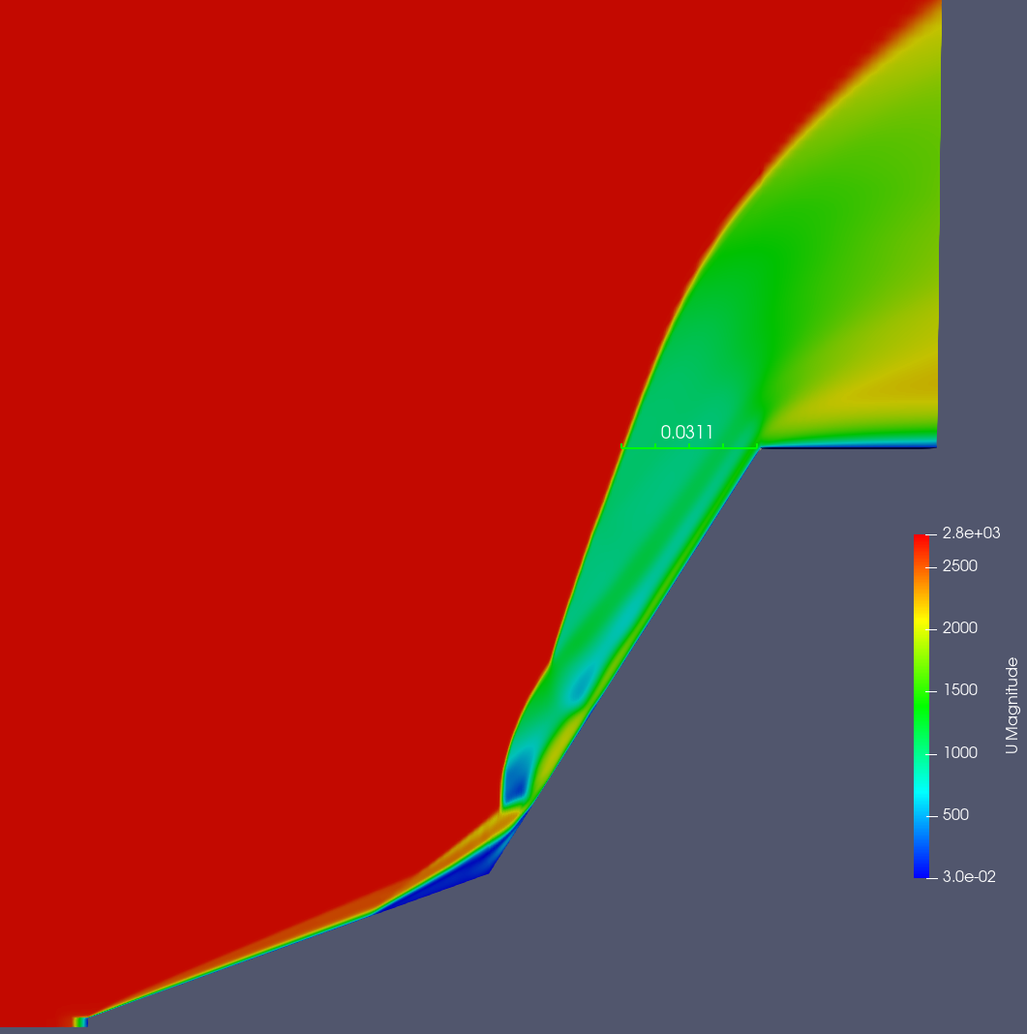
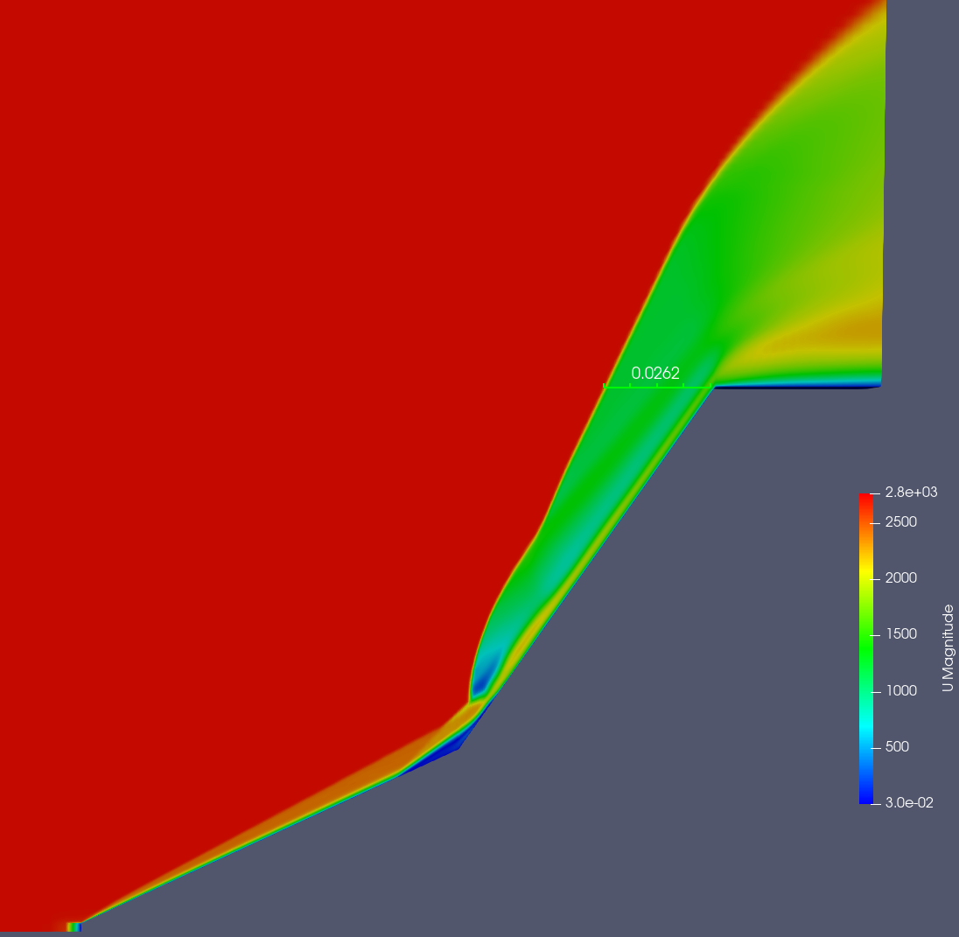
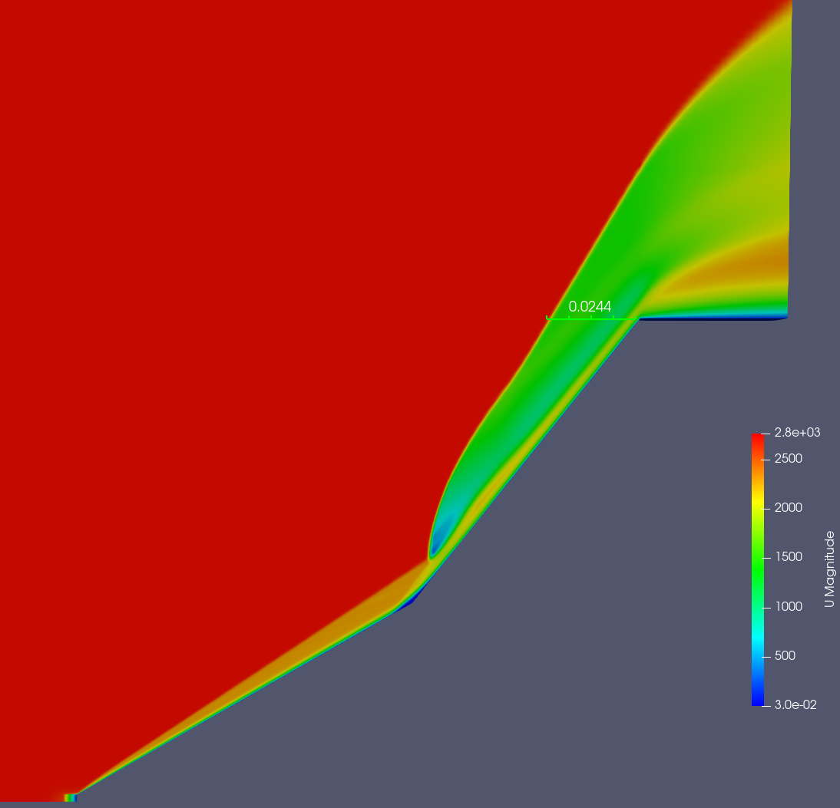
Shock stand off distance @ M=11.3
@20°
@25°
@30°
POLITECNICO DI MILANO

Slide 19
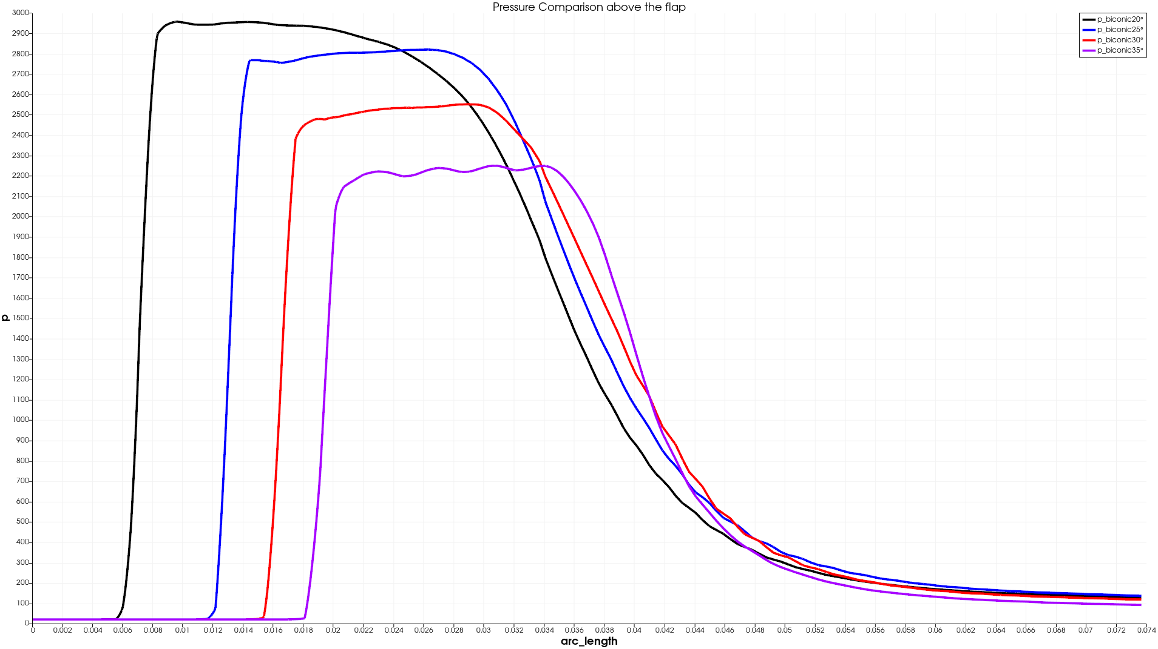
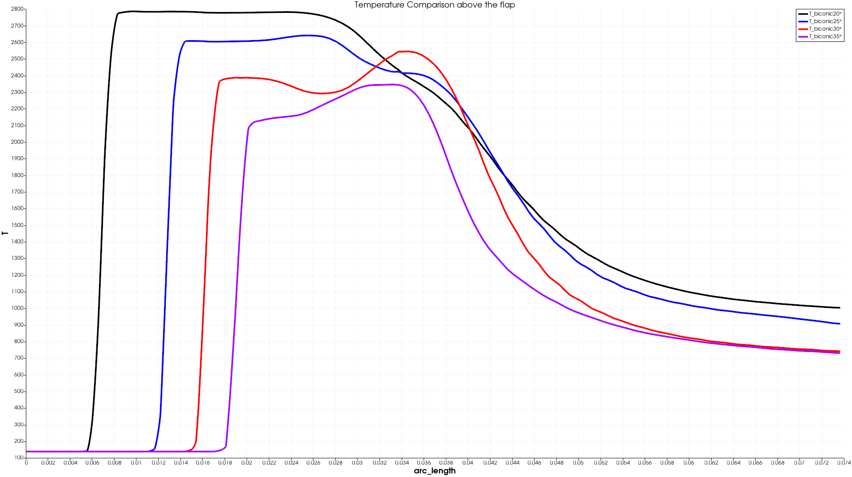
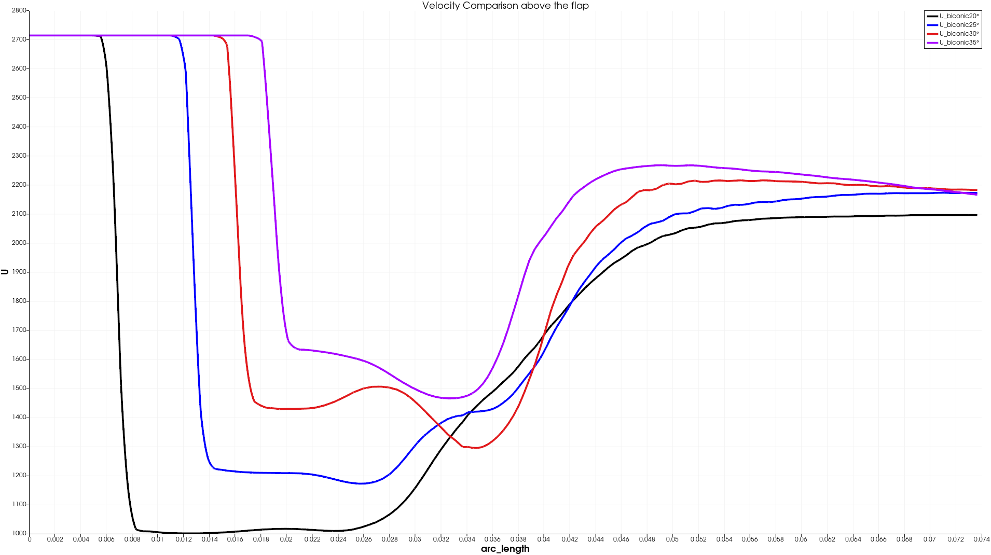
Profile comparison in region of flap
POLITECNICO DI MILANO

Slide 20
Shock stand off distance @ M=15
POLITECNICO DI MILANO

Slide 21
POLITECNICO DI MILANO

